Slide 2
LIFESCIENCES

Slide 3
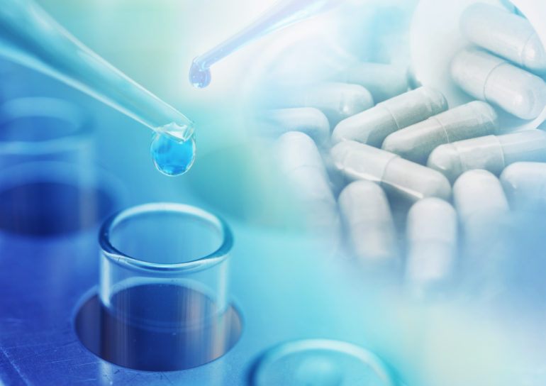
Pharmaceutical RESEARCH & DEVELOPMENT
The biotech sector accounts for a turnover in excess of MUR 2.3 billion
5 Contract Research Organisations involved in Clinical Trials
5 R&D Laboratories
More than 75 clinical trial licenses issued
Pre-clinical studies being undertaken
Availability of resources for clinical and preclinical studies
Mauritius has a multi-ethnic, drug naive population
2.3 million km2 exclusive economic zone with vast pool of marine biological resources
R&D Overview

Slide 4
Healthcare Sector Overview
An integrated cluster supported by a core group of high-value activities - hi-tech medicine, medical tourism, medical education, research and wellness.
State of the art medical facilities and highly qualified personnel to cater for the growing needs of both domestic and international patients.
Over the years the number of private institutions health institutions, nursing homes and specialized clinics have increased considerably, and future projections indicate that the sector is expected to substantially contribute to GDP and become a pillar of the economy.
The presence of global healthcare players on the island has positively increased competition and enhanced the image of Mauritius as a high tech medical hub.
Healthcare Sector Overview

Slide 5
Healthcare Sector Trend
A relatively steady growth rate observed over the last few years owing to its strengthening coverage, services and increasing expenditure by public as well as private players
GDP Contribution as of 2020: 5.4 %
Real GDP is estimated to have contracted by 15% in 2020, against a positive real GDP growth of 3% in 2019.
As per the Ministry of Health, employment in the sector totals to 8700
More than 4500 beds in both public and private sector

Slide 6
Healthcare Personnel
Over 40% of WHO Member States report to have less than 10 medical doctors per 10 000 population.
--- Over 26% report to have less than 3 ---
Mauritius reports:
25.9 Doctors per 10 000 population
35.5 Qualified Nurses per 10 000 population
3.2 Dentists per 10 000 population
4.2 Pharmacists per 10 000 population

Slide 7
Regulatory Framework
Mauritius has established the appropriate regulatory frameworks for pharmaceutical and biotech industry based on the best practices including US FDA, the EU Directives and Good Manufacturing Practice of the World Health Organization
(1) Clinical Research
- Clinical Research Regulatory Council (CRRC) responsible for the regulation and control of trial licenses being issued.
- Ethics Committee (EC) to advise the CRRC regarding welfare, safety, health and protection of human subjects participating in clinical trials.
- Pharmacovigilance Committee (PC) to monitor all clinical trials being performed and ensure Good Clinical Practice (GCP).
(2) Preclinical Research
- As per provisions of the Animal Welfare (Experiment on animals) Regulations 2017, pre-clinical trials can be undertaken, following strict consideration of Animal welfare, on 4 species of animals namely macaques bred in Mauritius, mouse, rabbit and rat.

Slide 8
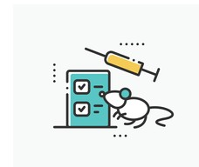
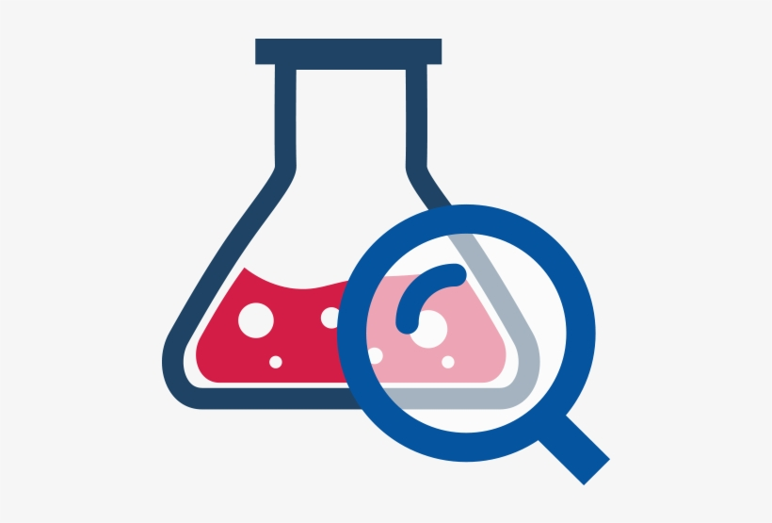
Opportunities
Clinical Research
Pre-clinical Research
Nutraceuticals
There is a rising incidence of cancer, cardiovascular diseases, diabetes and hypertension amongst others in Mauritius. In this regard, Mauritius provides an ideal platform for clinical research. Clinical trials (Phase I– Phase IV) are performed in partnership with specialist doctors in the field.
Primates (Cynomolgus Macaques) are exported from Mauritius to leading pharmaceutical and biotech companies for pre-clinical research purposes.
These primates are known to be virus-free and genetically homogenous, which make them also very effective in pre-clinical research.
Mauritius has a rich and diverse flora, with more than 670 species of flowering plants of which 315 are endemic. Furthermore, the East African region is already considered as a biodiversity hotspot. This represents a tremendous opportunity for the development of a nutraceutical industry.

Slide 9
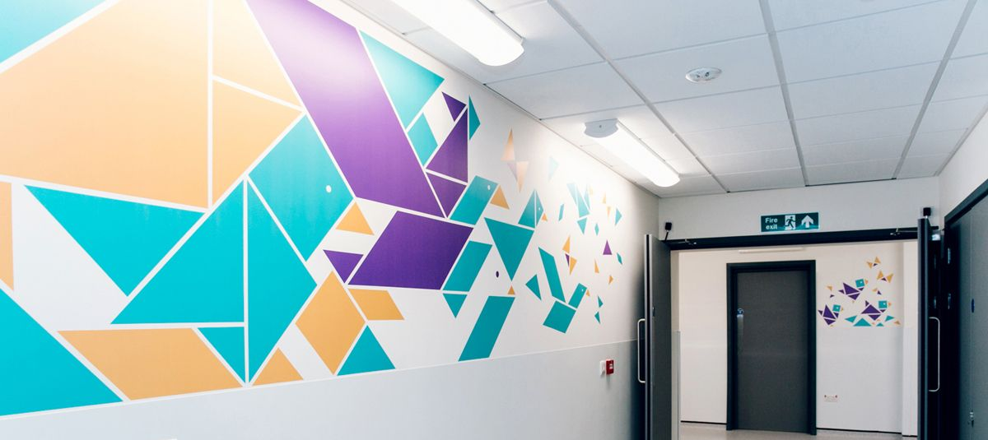
Infrastructure
-State-of-the-art infrastructure and facilities
-Extensive network of double taxation avoidance agreements and Investment Promotion and Protection agreements
Trained Manpower
- Highest literacy Rate in Africa
- Qualified and trained scientists
- Educated, multilingual, disciplined and sophisticated workforce
ADVANTAGE MAURITIUS
Attractive Incentives
- Accelerated depreciation of 50% in respect of capital expenditure incurred on R&D
- A double deduction in respect of qualifying expenditure on R&D directly related to the entity’s trade or business and provided the R&D is carried out in Mauritius.
Attractive Incentives
- Exemption of registration duty on acquisition of immovable property in the lifesciences sector
- VAT exemption on construction of medical R&D centers.
- VAT exemption on plants and equipment.
- 8 years tax holiday for companies involved in manufacture of nutraceuticals and pharmaceutical products.

