Slide 1


Slide 2


Mauritius Fishing and Aquaculture Sector

Slide 3


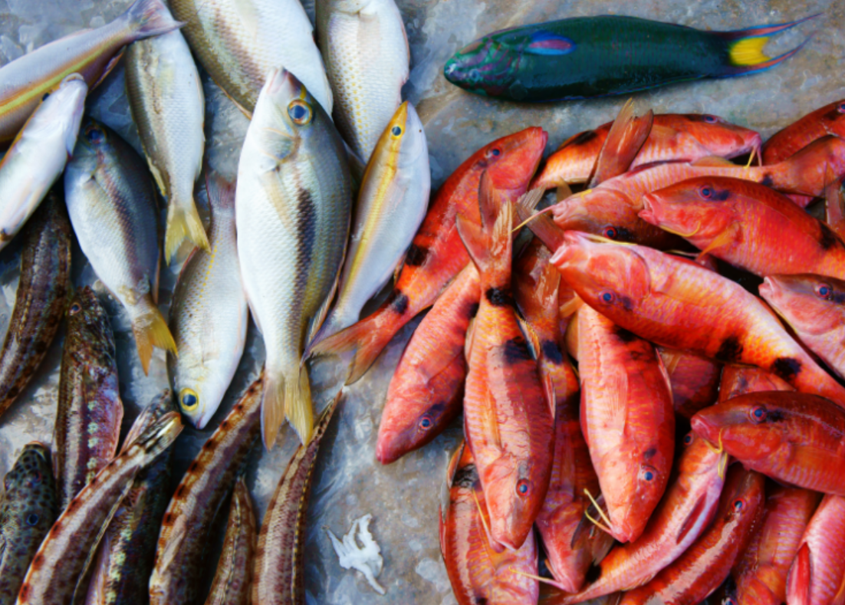
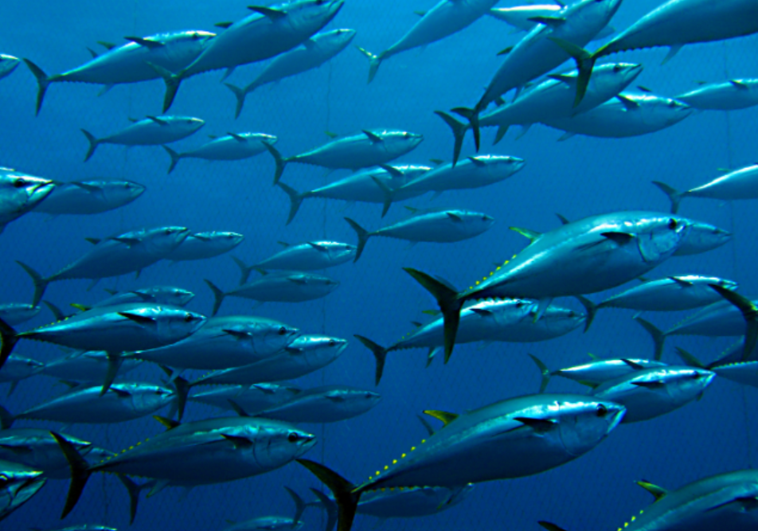
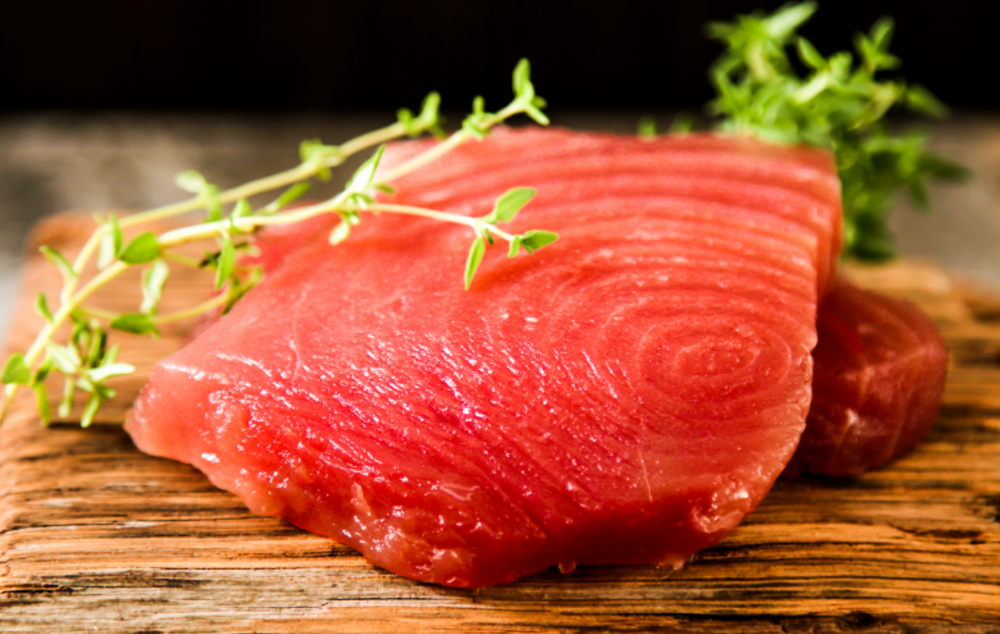
Investment Opportunities - Fishing Sector
Coastal, Semi and Industrial High Sea Fishing:
  ​Fishing license to longliners and Purse seiners (Foreign and Local flagged)
  Flagging Process to vessels
    < 24 metres – Registration with the fishing division at the Ministry of Blue Economy, Marine Resources, Fishing and Shipping​
    > 24 metres - Registration with the shipping division at the Ministry of Blue Economy, Marine Resources, Fishing and Shipping (vessels need to be classified)
8-year tax holiday for companies engaged in industrial fishing
Air freight rebate on export of chilled fish
Competent Authority Seafood responsible or the verification and certification of fish and fish products for export primarily to Member States of the European Union (EU) as well as to non-EU countries
Emerging : National fleet (3 Purseiners – Tuna centric- Longline opportunities)
Nascent : SIOFA Fisheries, Bank Fisheries & Untapped Resources
Processing of high value-added products: Fish oil & Fish meal

Slide 4
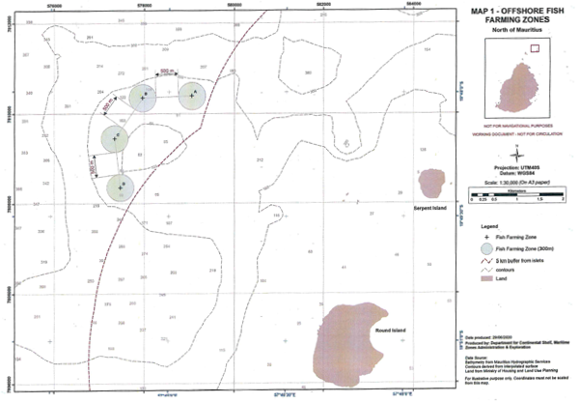

Investment Opportunities – Off Lagoon Aquaculture
4 new sites available for Off-Lagoon Aquaculture

Slide 5
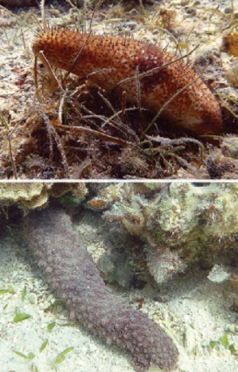
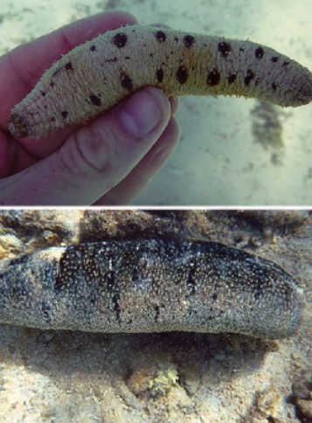
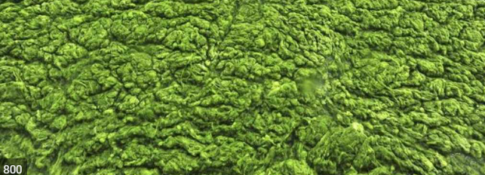

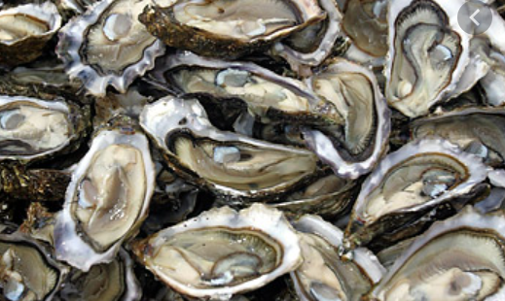


Investment Opportunities – In lagoon Aquaculture
Ecosystem Opportunities: Oysters, Algae, Sea-Cucumbers and Seaweed
Implementation of new framework for in-lagoon aquaculture

Slide 6
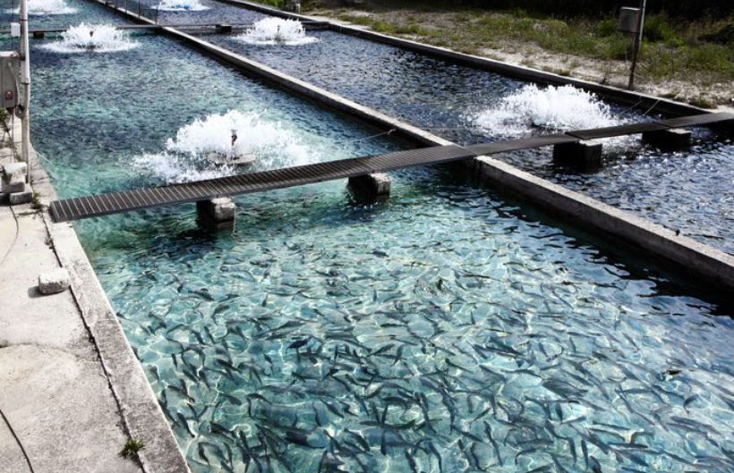
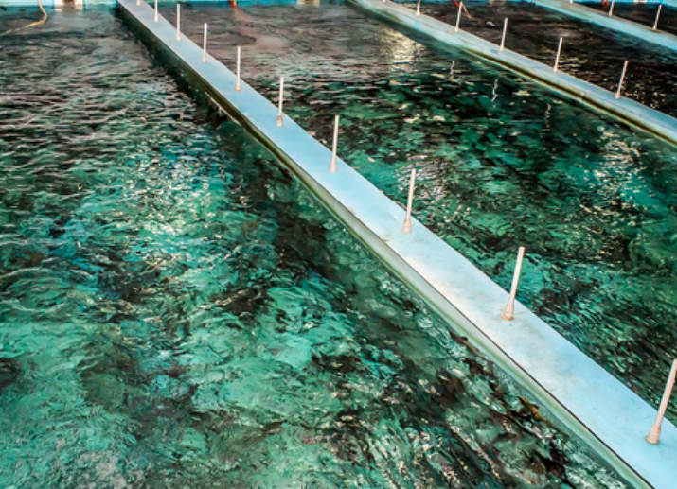
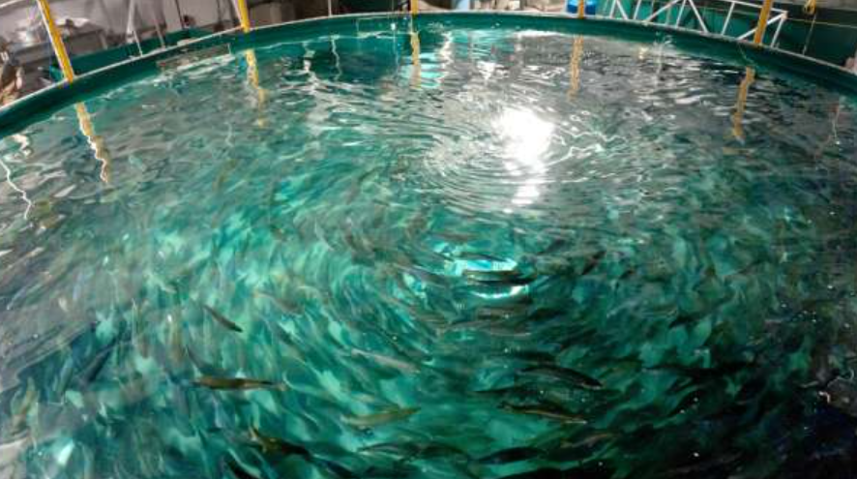
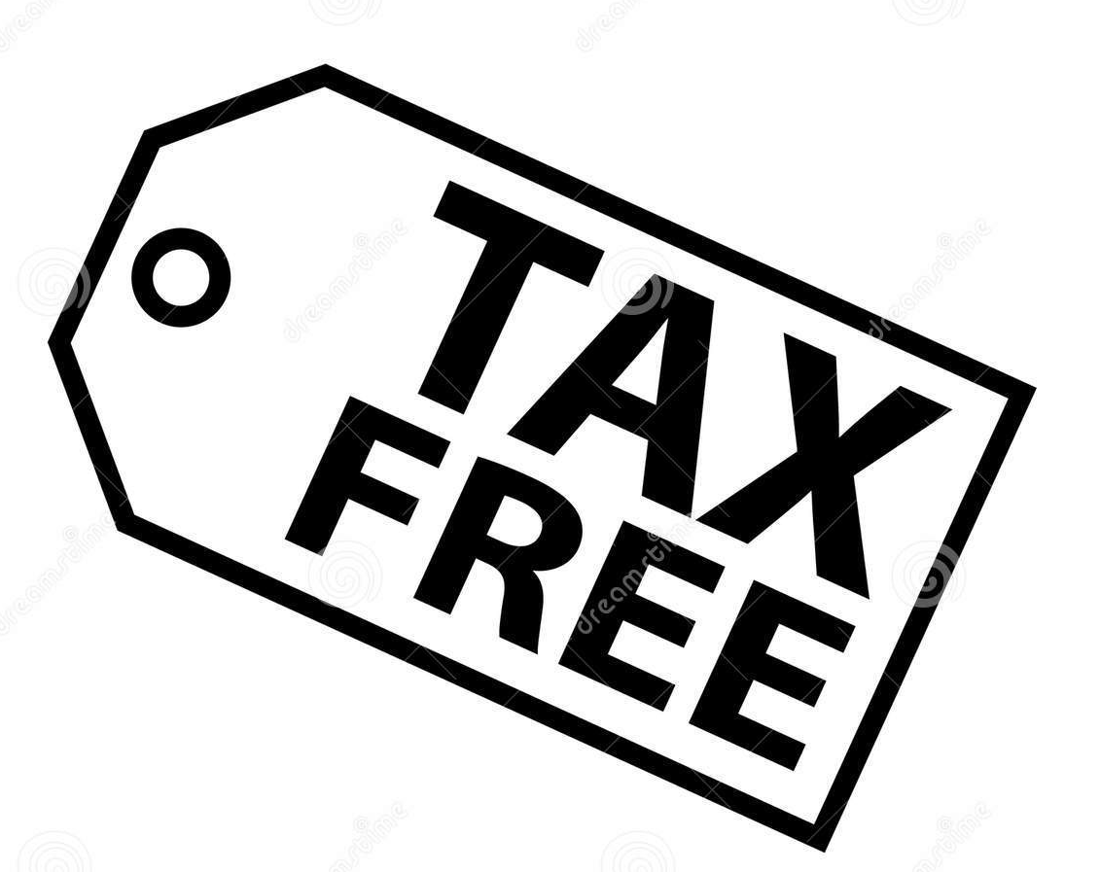

Investment Opportunities – In Land Aquaculture
Mauritius Inland Aquaculture is one of the key sectors identified by Government to boost local fish production and increase exports of locally produced seafood products.
8-year tax holiday for Inland aquaculture projects
VAT and Duty exemptions on equipment for Inland aquaculture

Slide 7



Why Mauritius?
Fiscal Policy
8-year tax holiday for companies engaged in industrial fishing
No import duties on equipment and raw material
VAT on raw materials is payable at customs clearance but reimbursable on exports
Corporate tax at 3% for export-oriented enterprises​
Value added tax at 15%
Personal and Corporate tax rate harmonized at 15%
Tax-free dividends
No restriction on ownership: 100% foreign ownership allowed
No exchange controls: free repatriation of profits, dividends and capital
No minimum foreign capital required
Capital and annual allowances for investment in equipment
Other Incentives
Air freight rebate on export of chilled fish
Modern infrastructure for setting up factories
Modern Freeport and logistics facilities
Sea and air connectivity through major shipping lines and airlines, respectively
Streamlined procedures for the recruitment of expatriates and foreign labour
Secure investment location with established rule of law
Freest and most business-friendly country in Africa
Unique lifestyle with a blend of cultures
Flexible and skilled workforce along with an investment friendly regulatory regime
Multi ethnic and skilled pool of bilingual (English & French) workforce
Convenient time zone (GMT +4)
Market Access
Mauritian exports benefit from preferential market under various agreements:
  Access to the US market under the Africa Growth Opportunity Act (AGOA).
  Ease of access to the European Union under the Economic Partnership Agreement (EPA).
  Access to COMESA and SADC countries as well as to IOC (Indian Ocean Commission) countries

Slide 8
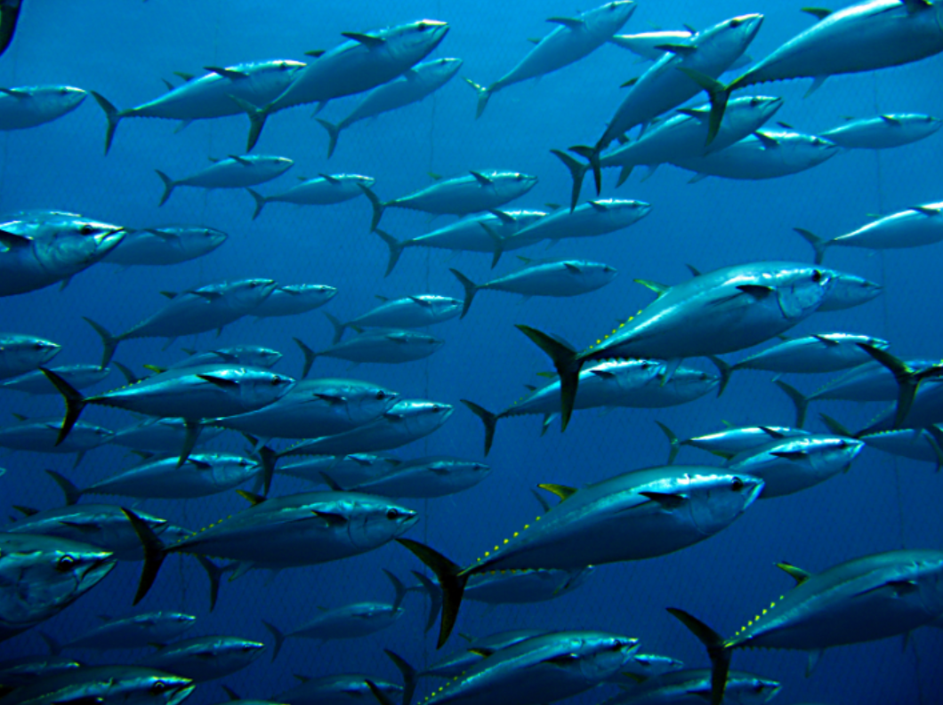
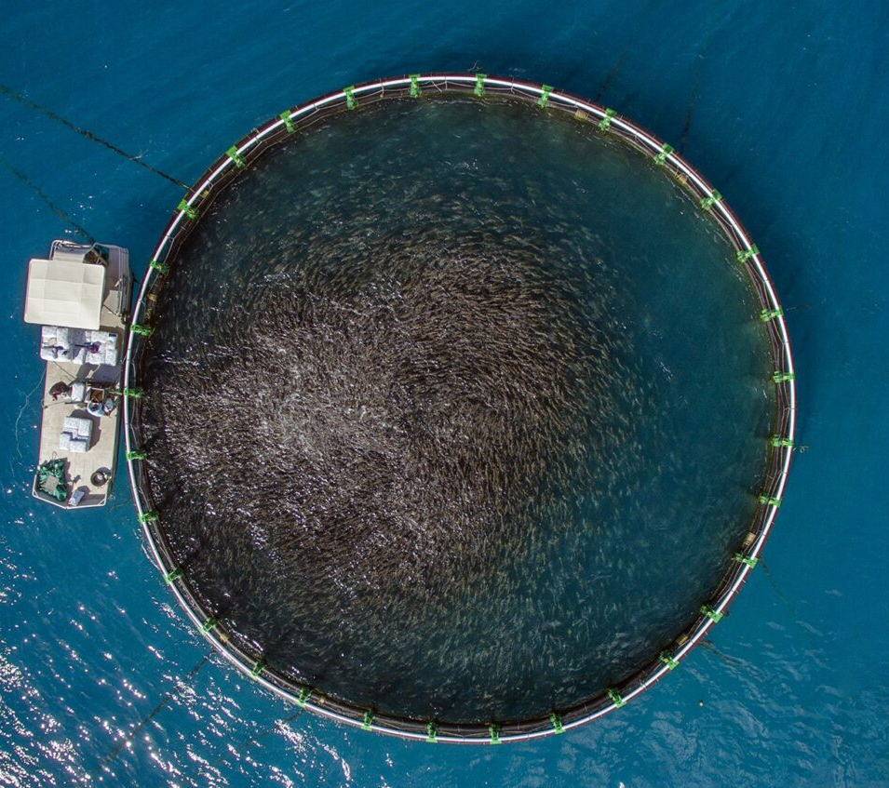

Mauritius Your Investment Destination

