Slide 1


Mauritius
Transitioning into a Digital Hub

Slide 2


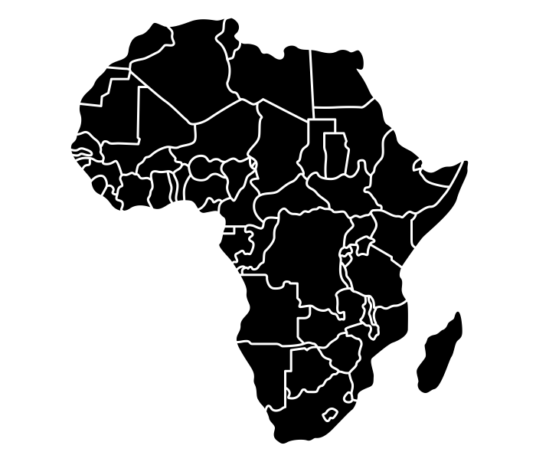



International Accolades
A Competitive & Attractive Business Climate
World Bank Ease of Doing Business (2020)
13th globally
United Nations Development Program (UNDP) (2021)​
Forbes Survey of Best Countries for Business (2019)
39th globally
1st African country
1st in Africa
Economic Freedom of the World (2019) – Fraser Institute
Global Competitiveness Index (2019)
52nd globally
9th globally
Global Cyber Security Index 2018
14th globally

Slide 3
International Accolades
A Competitive & Attractive Business Climate
Global Innovation Index 2020
Mauritius is the regional leader in Sub-Saharan Africa and 52nd in the world
Kearney Global Services Index (2021)
Mauritius is 27th globally and among the top 25 nations and 1st in Africa in the ‘digital resonance’ – ranking’

Slide 4
Key Milestones
2002
2004
2009
2012
2015
2016
2018
2020
2021
Promulgation
of the
Data Protection
Act
Transformation of Mauritius into a Digital Island
Ratification of Convention 108 +
Fibre Optic
SAFE/SAT3
March
Connection to 3rd submarine cable: METISS
June
1st Mauritian Nanosatellite MIR-SAT1 in Orbit
Construction of the Cyber Tower Enactment of the Data Protection Act
Connection to 2nd submarine cable : LION
Promulgation
of the new
Data Protection
Act

Slide 5




Overview of the ICT-BPO Industry 2020
Industry Growth Rate
3.9%
Connectivity: Mobile Penetration
151%
GDP Contribution
7.0%
Connectivity: Internet Penetration
130%

Slide 6
Overview of the ICT-BPO Industry 2019
Number of Companies
Professionals employed in the ICT-BPO Sector

Slide 7
Segmentation of the Industry
Business Process Outsourcing
Non-BPO Voice:
Functional shared service centres
Knowledge Process Outsourcing:
Legal Process Outsourcing
Data Analytics and Research
Financial outsourcing & BI
Multilingual Translation
39%
BPO - Voice
Call Centres | Contact Centre|
Technical Helpdesk | CRM
Information Technology
Outsourcing
Software Development
Mobile Apps Development
27%
Start Up
Fintech
E Commerce
Other Emerging Technologies
9%
25%
IT Services
Data Centers/Business Continuity | High End IT Consulting|Cybersecurity Auditing

Slide 8






ICT-BPO Investment Opportunities
ITO
BPO Voice
Software Development
Mobile Applications Development
Web Design & Development
Infrastructure Management
Application Maintenance
3D Design & Modeling
IOT
Inbound & Outbound Calls
Helpdesk & Technical Support
Advisory
IT Services
KPO
Creative Process Outsourcing
High End Technical Support
Translation and legal Processing
Quality and Functional Shared Services Centers
Data Centres
Disaster Recovery
Cloud Services
Consultancy
Training
Emerging Technologies
Digital Content
E-Commerce/ E Retail
Electronic Payment
Blockchain
AI
Cybersecurity & Cloud Computing
Digital Health Technologies
Online Education (Edtech)
Digital Production
E-learning & Online
Training System
Animation
Mobile Games

Slide 9


















Companies leveraging Mauritius for Global Operations

Slide 10
Why Mauritius
1
Geo-strategic Position
6
Well established and regulated financial services centre
2
Political, Social & Economic Stability
Availability of highly qualified professionals, bilingual in English and French
7
3
Modern and Investor-friendly legal & regulatory framework
8
State-of-the-art infrastructure
4
Freest and most business-friendly country in Africa
9
Excellent service delivery in education, health and banking
5
10
Excellent quality of life
Fiscal Incentives

Slide 11
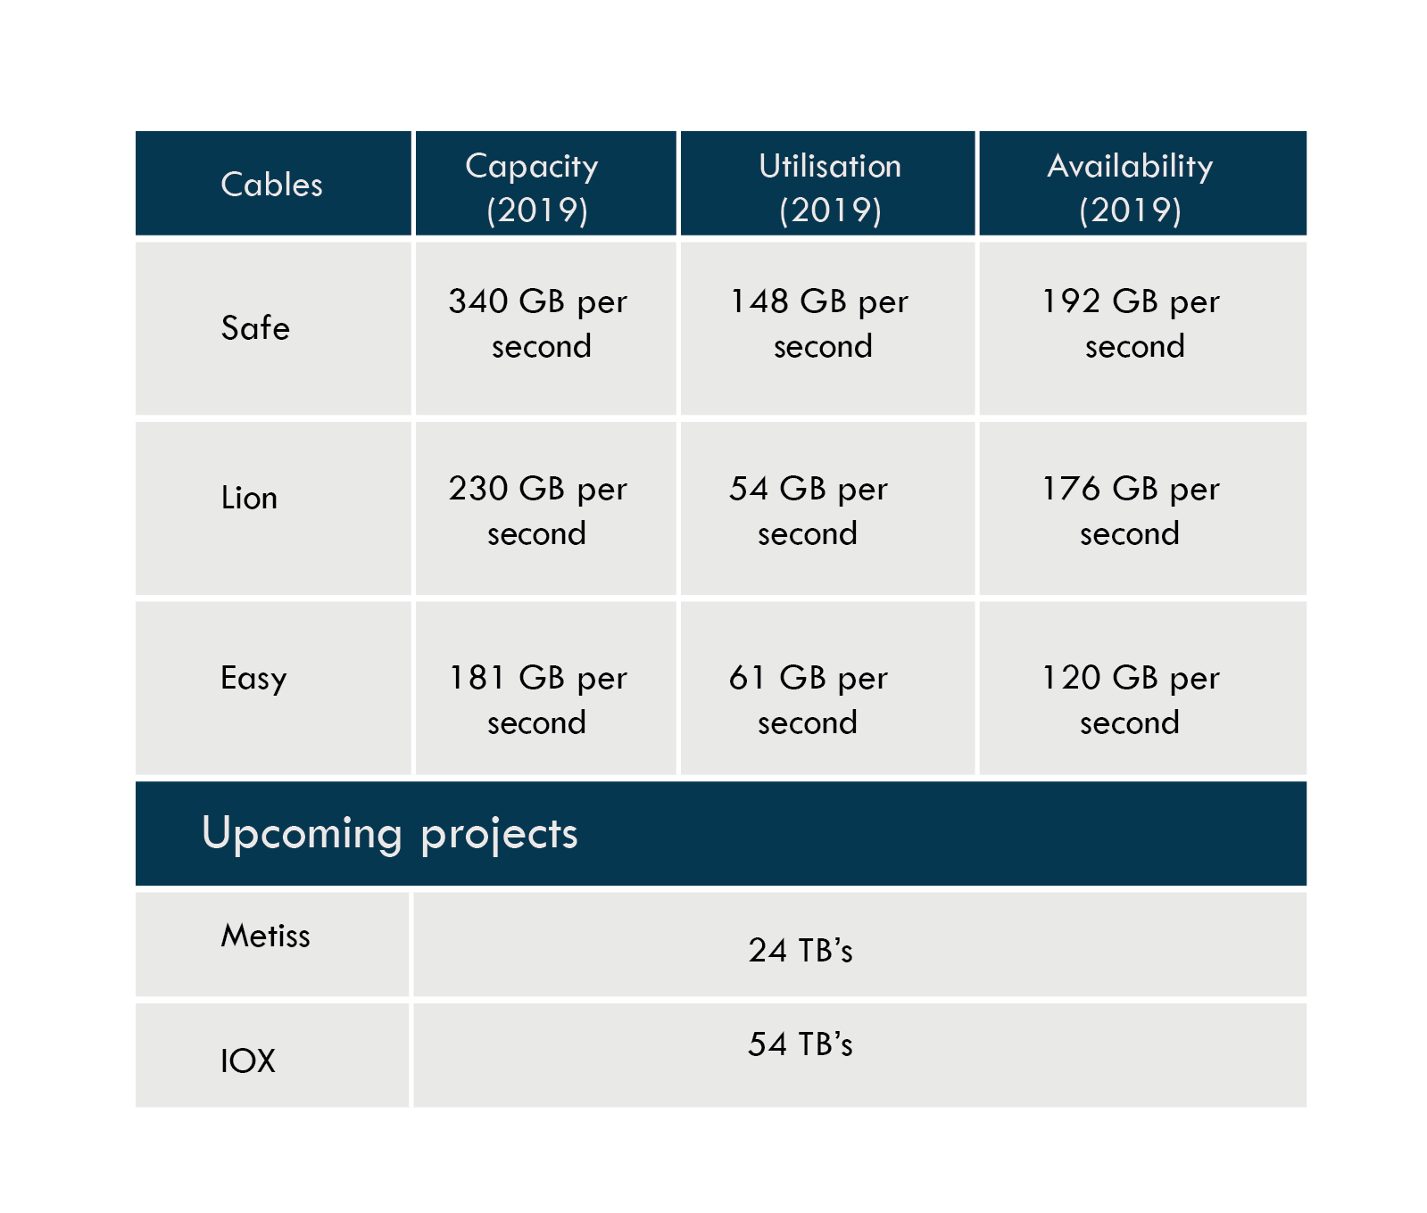
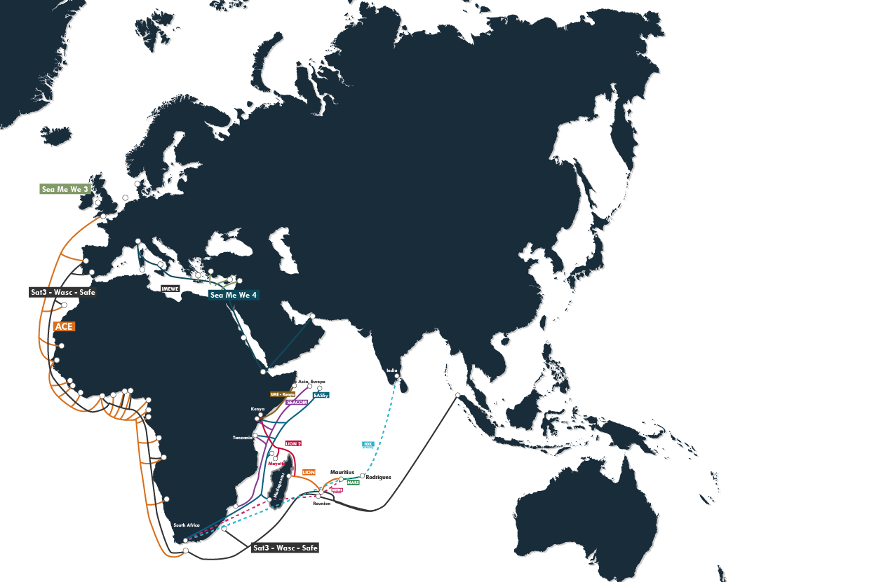
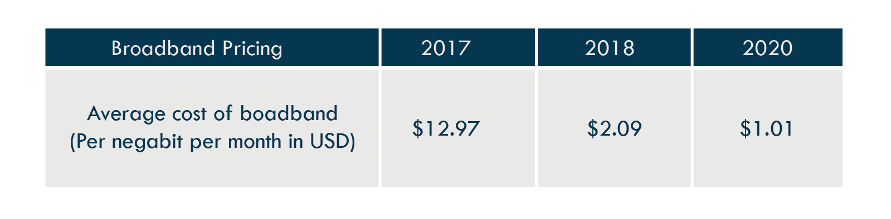
Resilient and Diverse Fiber Connectivity
New Cable – March 2021
The Melting Pot Indian oceanic Submarine System
(METISS)
24 Tbps
As from 2020, fully independent second national fibre backbone
with 100 Gbps availability through CEB Fibrenet
Mauritius became the 8th most fibred country in the world in terms of connectivity and the first in Africa.
5G licences granted to 3 main mobile operators

Slide 12

The Mauritius Talent Value Proposition
A bilingual, effective pool of talent
Science & technology
related : 1700
Customer service orientation
Affinity with Western, Indian, Chinese & African cultures
70% joining the services industry- 16,000 in the ICT sector
Abundant pool of accounting and business graduates
Cost effective &
highly trainable
Indicative Monthly Salary Costs:
Junior BPO Operator : USD 300-400
Junior BPO Officer : USD 400 – 500
BPO Supervisor : USD 500 - 600
Minimum Salary Applicable: USD 257
* USD : Rs 40/-
15,000 graduates annually

Slide 13

Government Support - Training Initiatives
Pre-employment programmes
Graduate Training Employment Program (GTES)
Up to Rs80,000 as funding for the cost of training per graduate
A monthly stipend of Rs6,000 per graduate will be offered by the HRDC
National Skill Development Program (NSDP)
Target group: Candidates possessing up to a diploma certification
100% reimbursement on training cost
Monthly Stipend of Rs 6,000 + Rs 1000 travelling expenses
Youth Employment Program
Target Group: Post HSC
Refund of 50% of the youth’s monthly stipend
Monthly Stipend: Rs 4000 (HSC), Rs 5000 (Diploma) and Rs 7500 (Degree holders)
Course refund up to 50%

Slide 14
Government Support - Training Initiatives
Post employment programmes
National Training Fund (NTF)
Refund up to 75% of course fees depending on their annual levy paid.
Various training offered to employers to meet part of the training cost of their employees and to support other training initiatives both at enterprise and national levels as per below:
Sectoral Skills Development Scheme (SSDS)
Clustering approach where enterprises will be able to share costs and availability of resource persons among themselves.
Recognition of Prior Learning Support Scheme
Formal recognition of the knowledge, skills and experience acquired at the workplace
Subsidies for facilitation and assessment fees amounting to Rs 5,000 and Rs 6,000

Slide 15
Government Support - Training Initiatives
Post employment programmes
Skills Development Support Scheme for Foreign Direct Investment:
To encourage development of higher levels of technical expertise
Assist in mounting skills development programmes with foreign investors.
Co-sharing ethos where HRDC provides funding for 80% of the training cost. The remaining is borne by the participating enterprise.
Cross Cutting Programmes
AI Skills Development Support Programme:
Collaborative projects between local and/or international institutions can be mounted for effective transfer of knowledge and build local capabilities
Fully funded programme by HRDC
Target group: Students, fresh graduates, existing professionals, lecturers/trainers, researchers are targeted beneficiaries

Slide 16












Workplaces and Parks with International standards
Smart City Projects :
1
Mont Choisy Smart City
Beau Plan Smart City
JinFei Smart City
Yihai Gardens Smart City
Royal St Louis Smart City
Montebello Smart City
Moka Smart City
Trianon Smart City
Uniciti
Cap Tamarin Smart City
St Felix Smart City
Mon Tresor Smart City
A
2
3
4
E
6
5
Vivea Business Park
Ebene cybercity
7
Ebene cybercity
8
B
9
10
Strategic Zones :
C
D
Riche Terre Business & Industrial Park
Cote D’Or City
Les Salines Masterplan
Rose Belle Pharmaceutical Village
Palmar Masterplan
12
11

Slide 17

A Robust Legislative Framework
Intellectual Property Rights
Security
ICT Act
Electronic Transactions Act
Computer Misuse & Cybercrime Act
Business Facilitation Act
Data Protection Act 2017
Copyright Amended Act (2017)
The Patent, Industrial Designs and Trademark Act 2002
The Protection against Unfair Practices (Industrial Property Rights) Act 2002
Industrial Property Act 2019 adopted by Parliament July 2019
DPA aligned to EU General Data Protection Regulation (GDPR)
1st country in Africa & 6th state after Bulgaria, Croatia, Lithuania, Poland and Serbia to ratify the modernised Convention 108 (Convention 108 +)

Slide 18
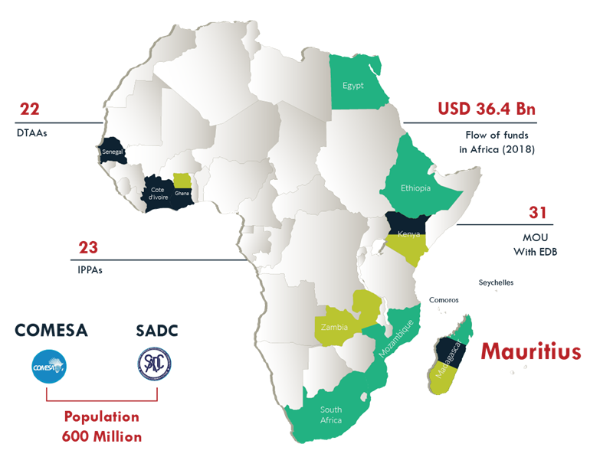
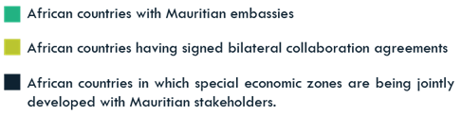
Gateway to Africa - A Premier Ecosystem
22
USD 36.4bN
Senegal - Industrial Park
Cote d’Ivoire – ICT & Biotechnology Park
Ghana - Technology Park
Kenya - Industrial & Logistics Park
Madagascar - Textile City
31
23
Mauritius
African Continental Free Trade Area (AfCFTA)
Markets Served:
Egypt
Sao Tome and Principe
Population :
600 Million

Slide 19

Transition towards
a Digital Island

Slide 20
Transition towards a digital island
New Areas of Growth
Creation of a nation of Digital Entrepreneurs
Capacity Building in New Technologies such as AI, Cybersecurity, Game development, RPA
An Open Data Portal for mobile applications developers and innovative solutions providers (230 datasets)
Issued several licenses under Regulatory Sandbox Scheme
Implementation of Innovator Occupation Permit with no minimum turnover and capital investment
Launch of National Payment Switch by BOM
Introduction of an IP Box regime
Implementation of the InfoHighway data sharing platform
130 E -Services and more than 10 national apps deployed
Data
Analytics
Fintech / Blockchain
Internet of Things
Artificial Intelligence & Machine learning
Cybersecurity
Robotics
Creative Outsourcing:
3D Animation,
3D Modelling
Games Development
Mobile Applications
Augmented / Virtual Reality

Slide 21

The Startup
Ecosystem in
Mauritius

Slide 22
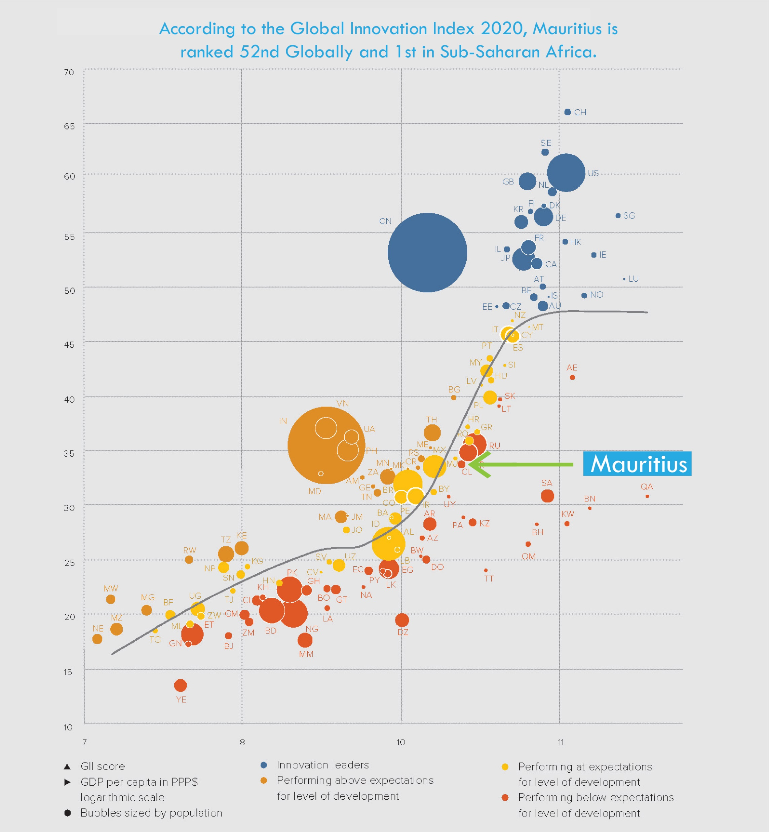
Positioning of Mauritius
Developments in the digital space currently offer the country the possibility of embracing new opportunities to grow the economy in fields such as:
Analytics and Big Data
Cloud Computimg
Financial Technology (FinTech)
Internet of Things (IoT)
Cybersecurity
Blockchain
Artificial Intelligence (AI)
Virtual and augmented reality
Digital Health Technologies
Ecommerce / E Retail
Online Education (Edtech)
There are around 80 technology start ups are currently operating and employ more than 200 people.
Activities range from provision of cyber security solutions, digital platforms, development of digital content, mobile apps,
blockchain based applications

Slide 23

Mauritius: The Ideal Platform for Fintech
REGULATORY SANDBOX LICENCE (RSL)
Caters for innovative projects in the absence of a regulatory framework
Growing number of start-ups in the FinTech space with approved RSL projects in:
Crowdfunding Platform
P2P lending platform
E-wallet
Digital Asset Exchange Platform
REGULATED ACTIVITIES
New licences
Custodian Services (Digital Assets) licence
Securities Trading Systems Licence
Peer to Peer lending Licence
UPCOMING INITIATIVES
Create crowdfunding as a new licensable activity
Digital Asset Marketplace licence

Slide 24
Exemption of 8 income years for Intellectual Property Assets, which are developed in Mauritius,
Double deduction of qualifying expenditure incurred for R&D purposes up to June 2027
Introduction of “ Young Professional Occupation Permit’ to allow students to work for 3 years in Mauritius,
National Incubator Scheme which is a part funding grant scheme for creation of new and innovative businesses,
VAT exemption on construction of building and related infrastructure and plant, machinery, equipment and materials to companies engaged in smart and innovative activities under Smart Mauritius Innovative Development Scheme (SMID),
Tax holiday of 5 years to companies for the development and domiciliation of electronic platforms and their related ancillary activities in Mauritius under Ecommerce scheme,
Refund of training expenses up to 75% to upgrade skills of employees,
Preferential electricity rate for ICT/BPO companies
For Companies:
Key Incentives

Slide 25
For Companies (cont'd):
New Budget Measures announced:
200 percent deduction from taxable income will be allowed on the acquisition of specialized software and systems in the Manufacturing industries
Exemption on trade fees not exceeding Rs 5,000 extended for an additional 5 years
Extension of the HRDC training fund to include digital transformation initiatives and business advisory services
Investment Certificate (8-year tax holiday, VAT exemptions/zero-rated, exemptions from registration duty for emerging sectors)
Premium Investor Certificate: Minimum investment of Rs 500 million (except Pharmaceutical Manufacturing) – In case of minimum investment (Incentives to be negotiated)
International students enrolled in a recognised educational institution in Mauritius will benefit automatically from 20 hours per week work permit.
Key Incentives

Slide 26
For Technology Start ups :
Loan facilities for start-ups, young entrepreneurs, women entrepreneurs at an interest rate of 3%
Loans facilities at a preferential rate of 0.5% per annum per enterprise up to a max of MUR 10 Mn;
Introduction of a Technology and Innovation fund to invest up to MUR 2 million as equity in projects recommended by MRIC;
Introduction of a subsidy of 15% on the cost of assets up to a maximum of MUR 150 000 under the DBM Enterprise Modernization Scheme;
SME equity fund in partnership with Fundkiss will invest up to MUR 200 000 per project through the crowdlending mechanism;
Introduction of a dedicated Venture Capital Market at the Stock Exchange of Mauritius for start-ups and SME’s
Key Incentives

Slide 27
For Technology Start ups (cont'd):
New Budget Measures announced:
Increase in the maximum investment through licensed crowd lending platforms by the IFI from Rs 200,000 to 1 million per project.
​
Provision of training and re-skilling to some 11,000 individuals over the next financial year: 1000 students under the SME Graduate Scheme​
Non-citizens holding an OP as self-employed will be allowed to incorporate a one-man company and employ administrative staff​
Exemption for payment of trade fees not exceeding Rs 5,000 for an additional 5 years​
Allocation of 20 percent of spaces in parks rent-free to start-ups for the first three years of operation​
Setting up of an online marketplace for start-ups to showcase their products and services
Setting up of a FinTech Innovation Lab by the Bank of Mauritius and the FSC to encourage an entrepreneurship culture
Issue a new guideline in respect of the usage of Application Programming Interface (APIs) to support open banking initiatives
Key Incentives

Slide 28

Work and Live in Mauritius
Reduced investment ceiling from USD 100 000 to USD 50 000 for Investor Occupation Permit for a period of 10 years;
Introduction of a new category - the 10-Year Family Occupation Permit for those contributing USD 250,000 to the COVID-19 Projects Development Fund.
Possibility for OP holders to bring their parents as dependents;
No restriction for spouses of OP holders to work in Mauritius;
Extension of Permanent Residence Permit from 10 years to 20 years;
Existing OP holders who have held the permit for 3 consecutive years will be eligible to apply for 20-year PRP

Slide 29
Work and Live in Mauritius
Reduced investment amount for an investor from USD 500,000 to USD 375,000 to obtain a Permanent Residence Permit
A holder of an Occupation Permit as Professional may invest in any business under certain conditions
Premium Travel visa allowing foreign nationals to come for a long stay for a period on one year renewable
A 10-Year renewable Young Professional Occupation Permit upon graduation.
Extension of the validity period for Professionals from 3 years to 10 years

Slide 30

Thank you
Head Office
France
India
South Africa
10th Floor,
One Cathedral Square Building
16, Jules Koenig Street
Port Louis 11328
Republic of Mauritius
Tel: +230 203 3800
Ambassade de la République de Maurice
127 rue de Tocqueville
75017 Paris
France
Tel: +33 (0)1.42.27.30.19
Regus Level 9 Platina
C-59 G Block
BKC Mumbai 400 051
India
Tel: +91 11 241 02 161
Unit 2, Katherine & West
114 West Street
Sandton
Johannesburg 2031
South Africa
Tel: +27780860072
www.edbmauritius.org

