Slide 1
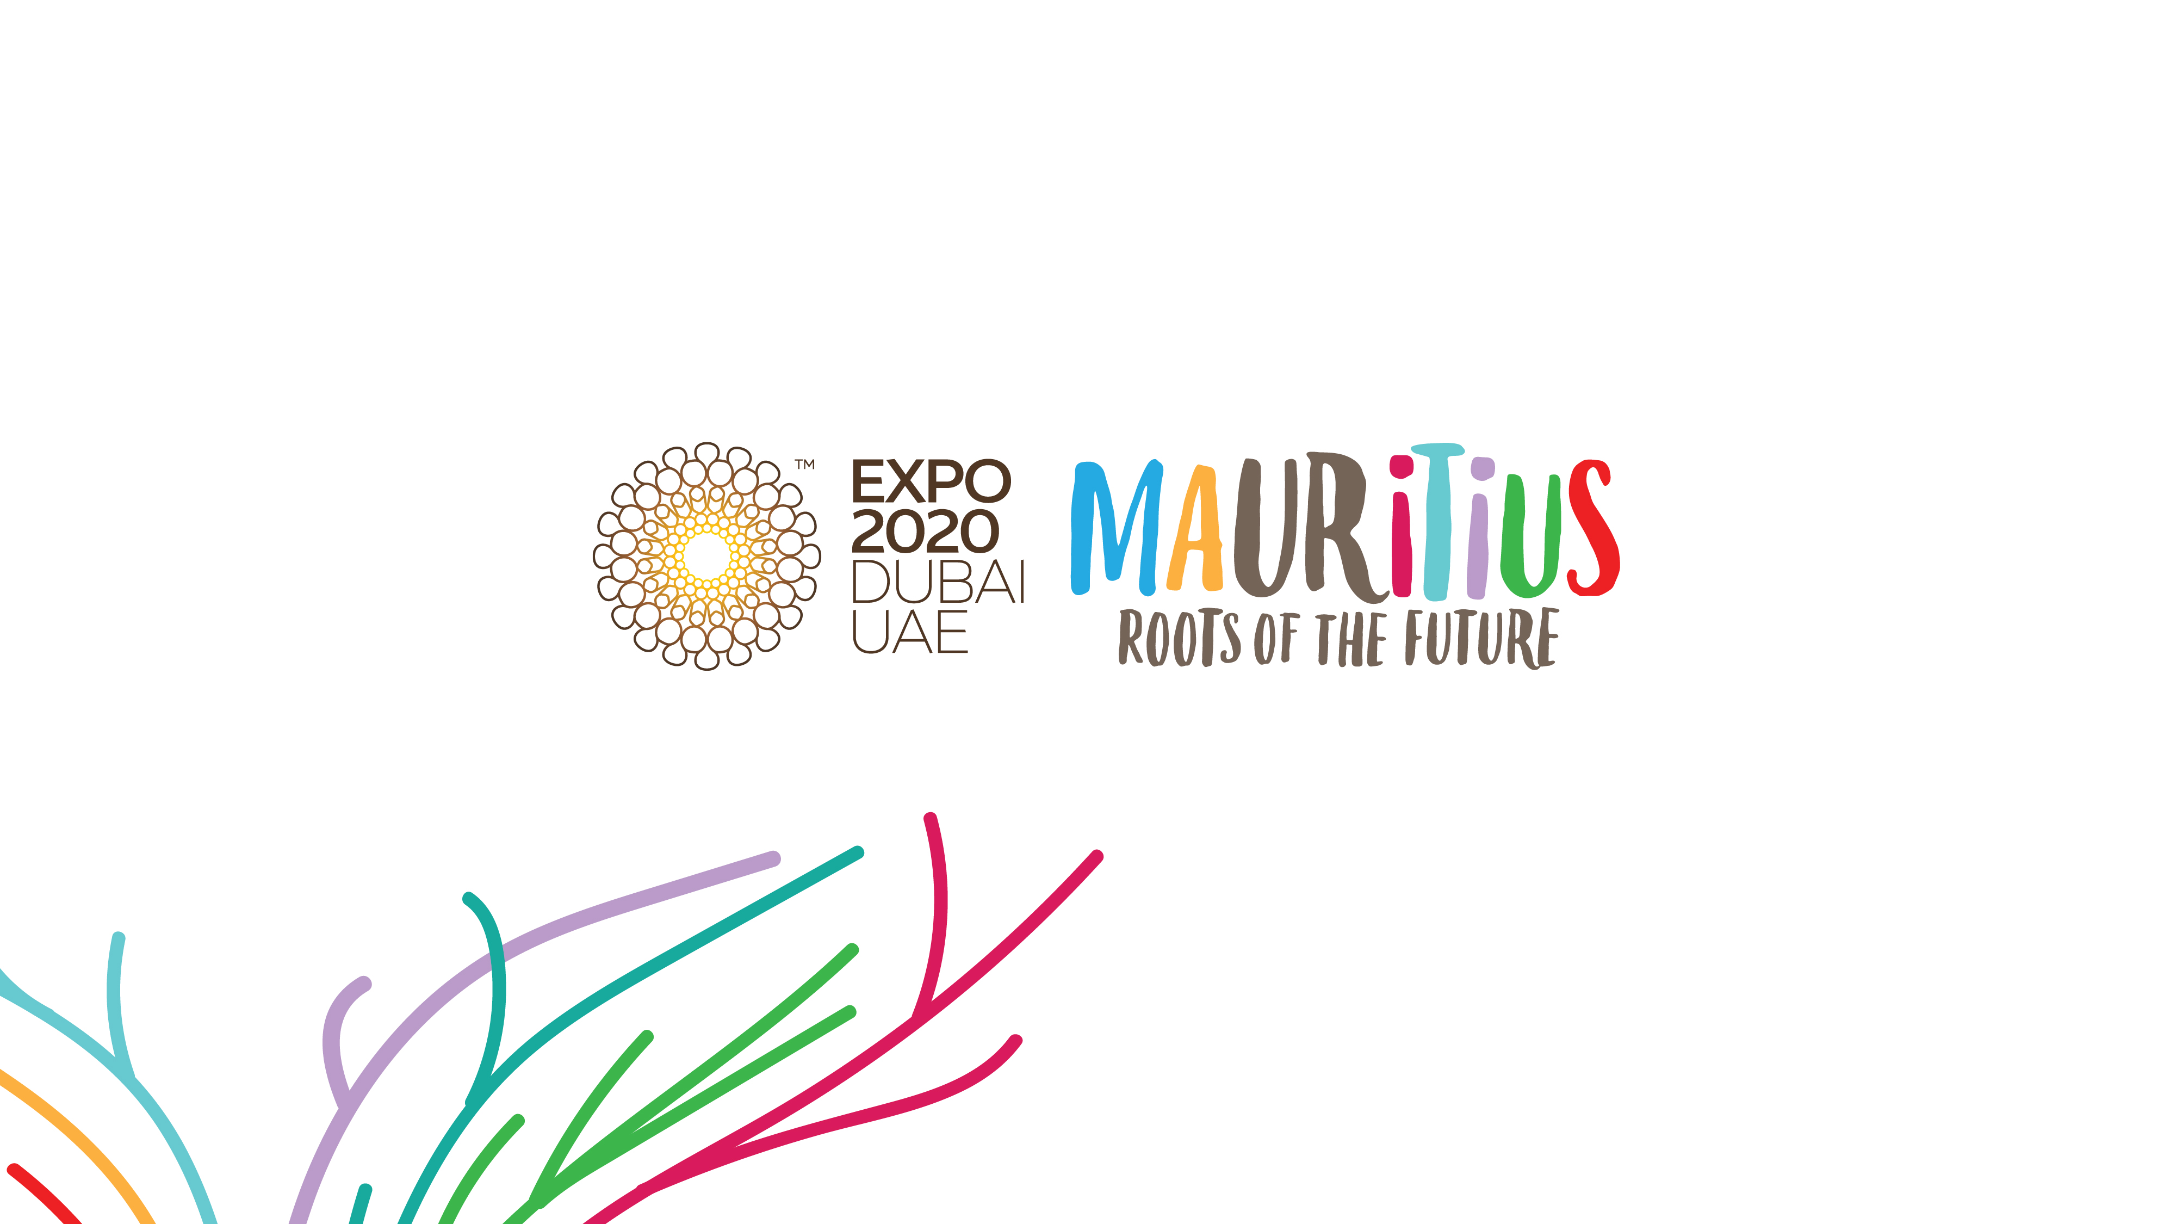

Slide 2

Real Estate

Slide 3







Real Estate in Mauritius
A Key and Robust Sector
Investment Opportunities
MICE
Office spaces
Smart Cities
+USD 1 Bn
Investment
11% of GDP
40K
Employment
Business / Industrial Parks
All figures are for 2019 & include Construction sector
Commercial
Shopping Malls, duty free shops, commercial complex, MICE (Meeting incentives conferences exhibitions)
Residential Development
(under property schemes regulated by EDB)

Slide 4

Why Real Estate in Mauritius ?
Income tax and Corporate Tax at 15 %
No Inheritance Tax and No Exchange Controls
Foreign ownership 100% allowed
No Dividends and Capital Gains Tax
No Tax on profits on sale of a property
No Property Wealth Tax
No Housing Tax
Registration duty & Land Transfer Tax at 5%
Robust Legal System
FISCAL
Well regulated
Investment protection
Attractive return on investment

Slide 5
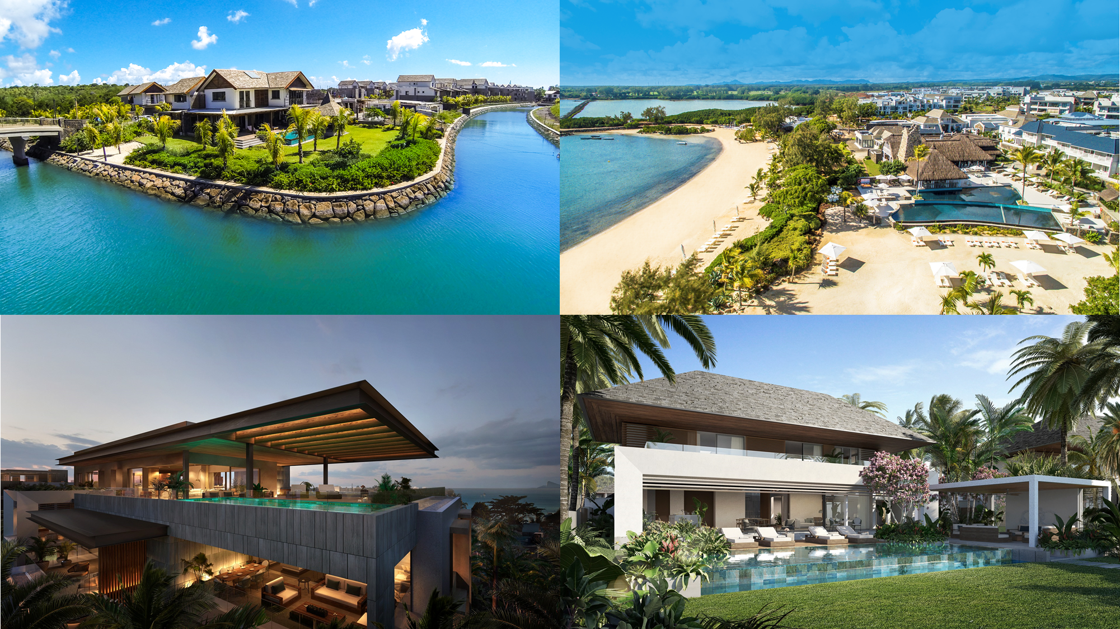
Acquiring a residential property in Mauritius
A Select and Exclusive market of high-end and luxury residences within world class amenities & environment
Villas
Apartments
Penthouse
Townhouses
Duplexes
Service plot of land

Slide 6
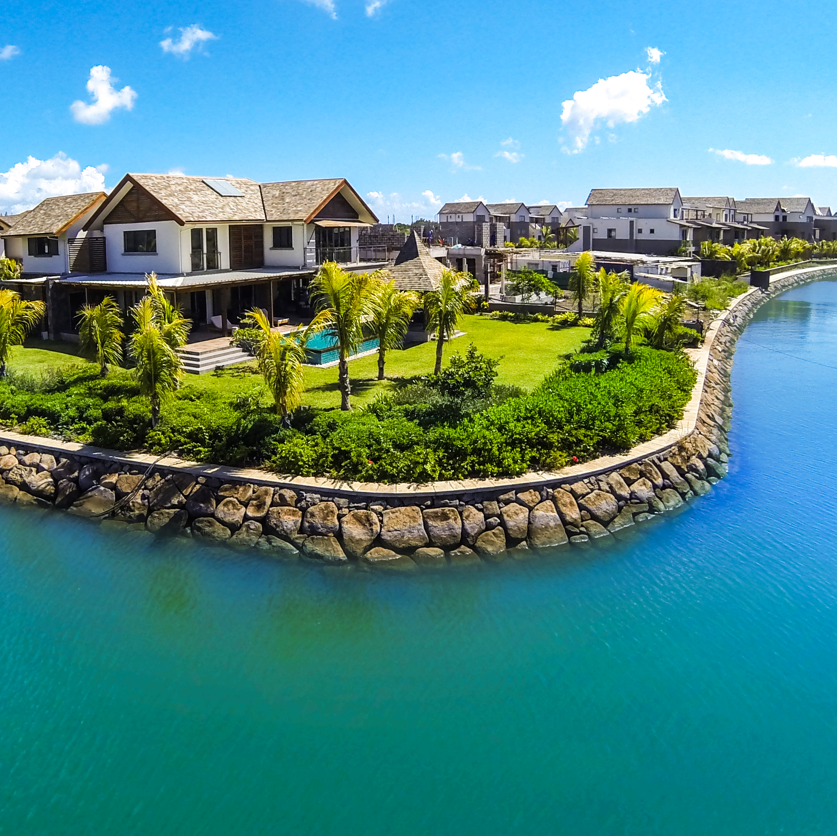
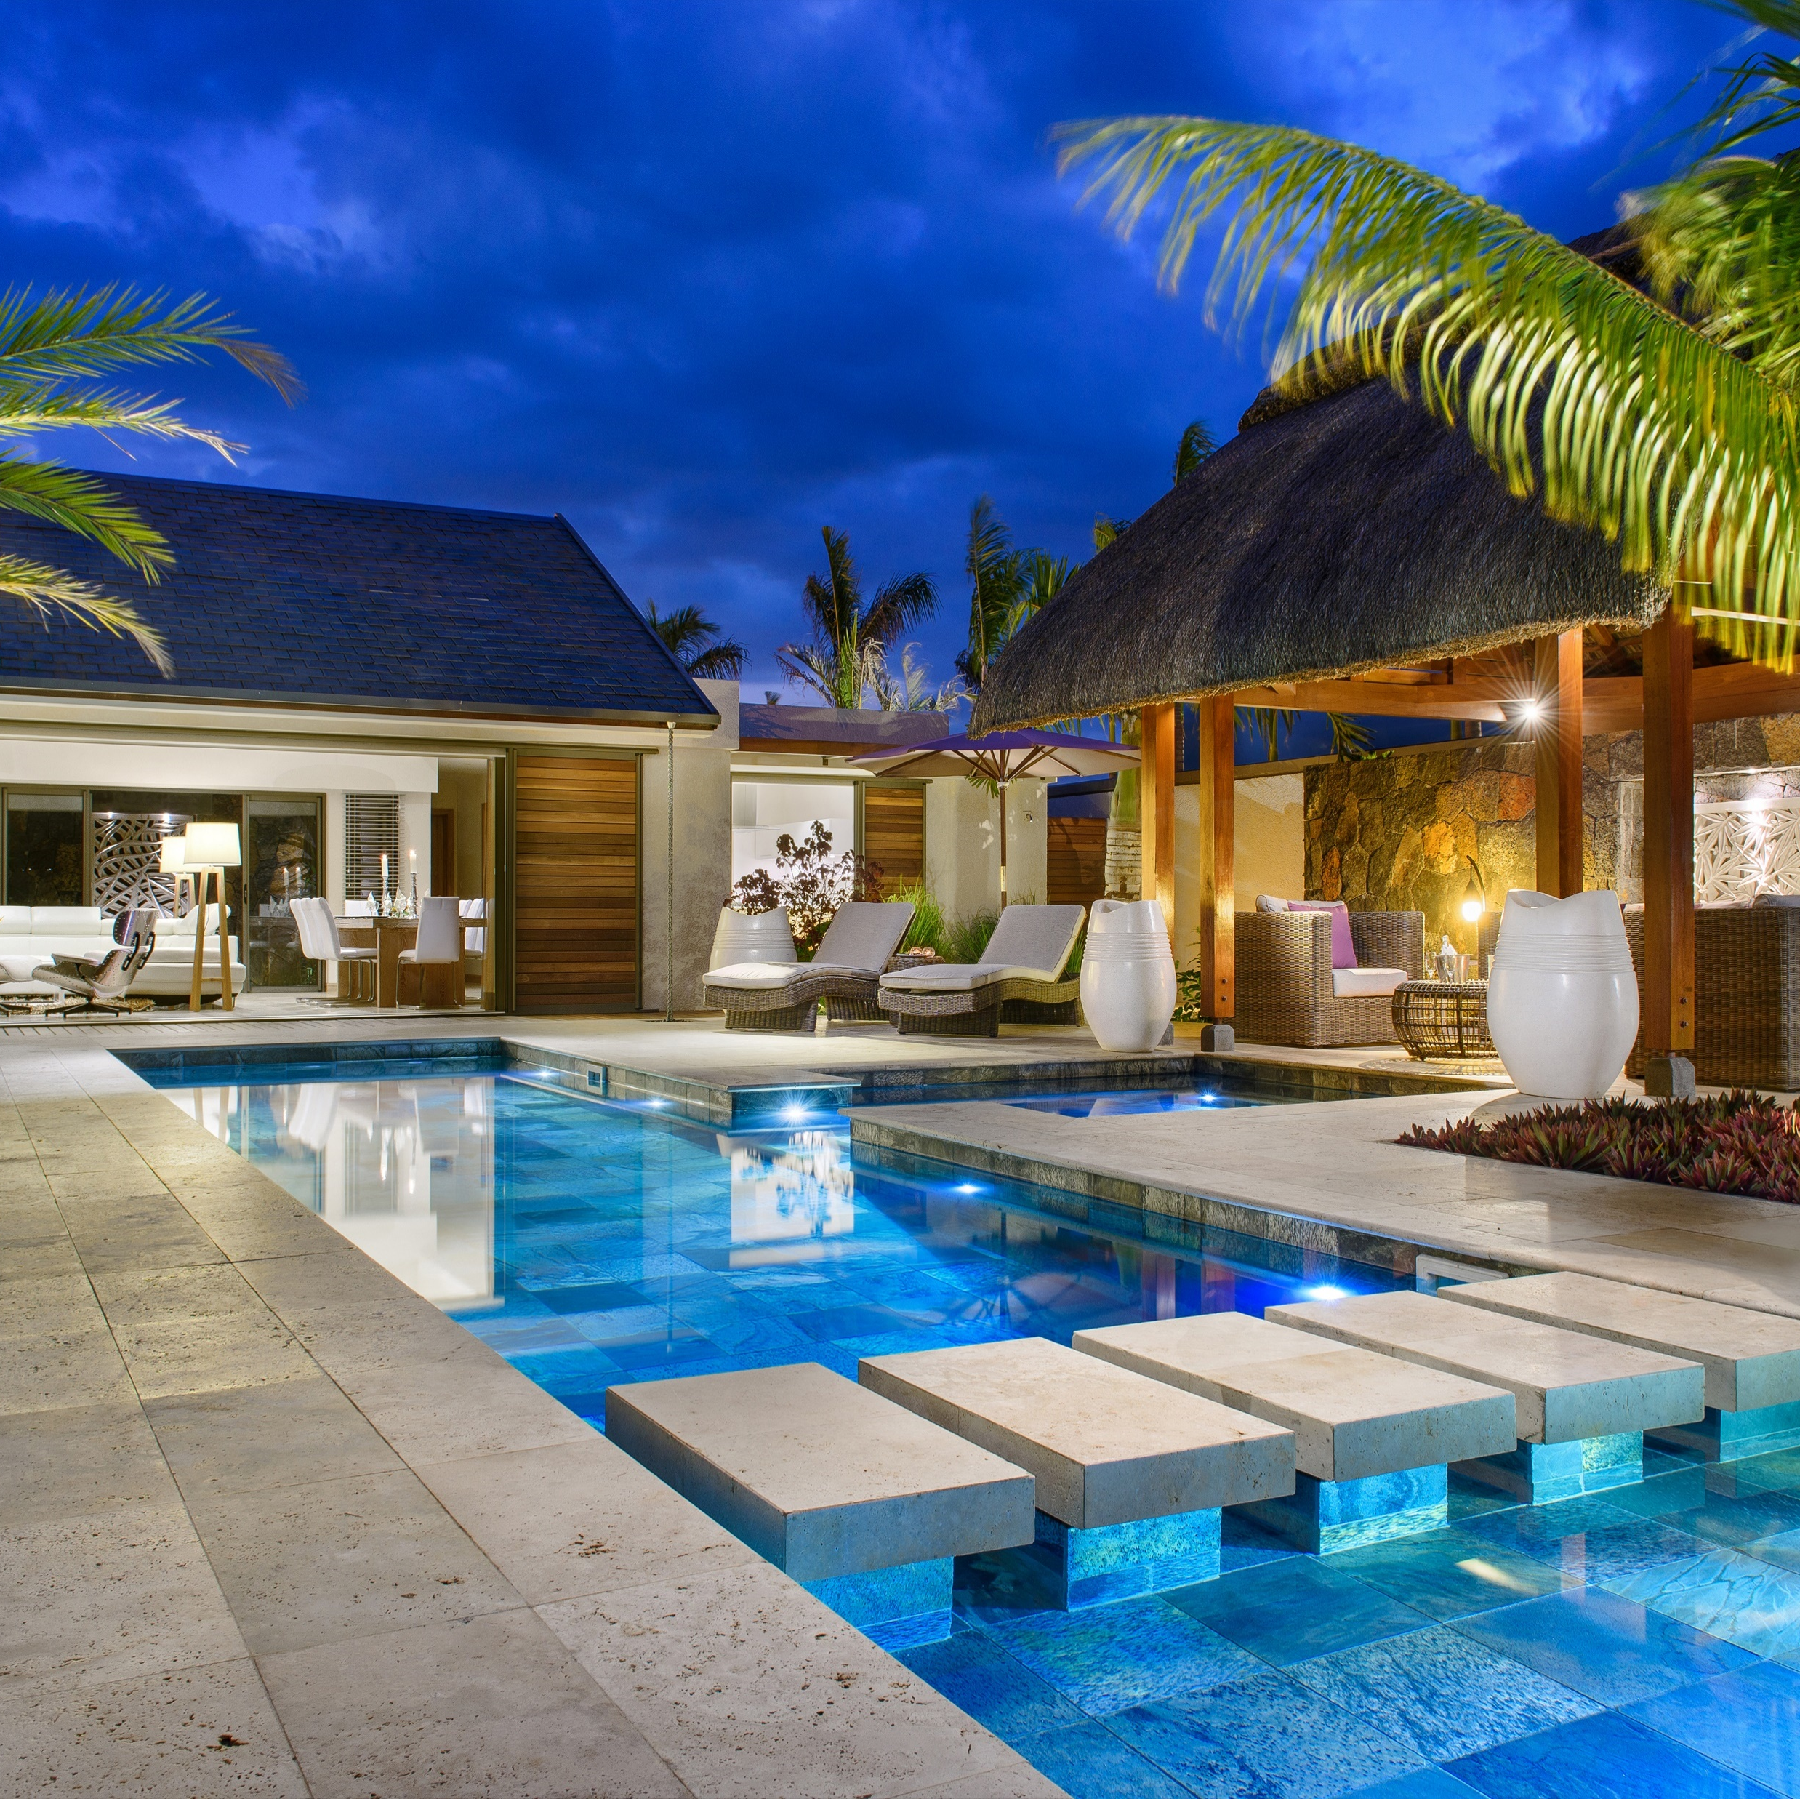
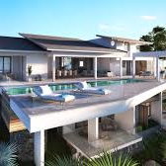
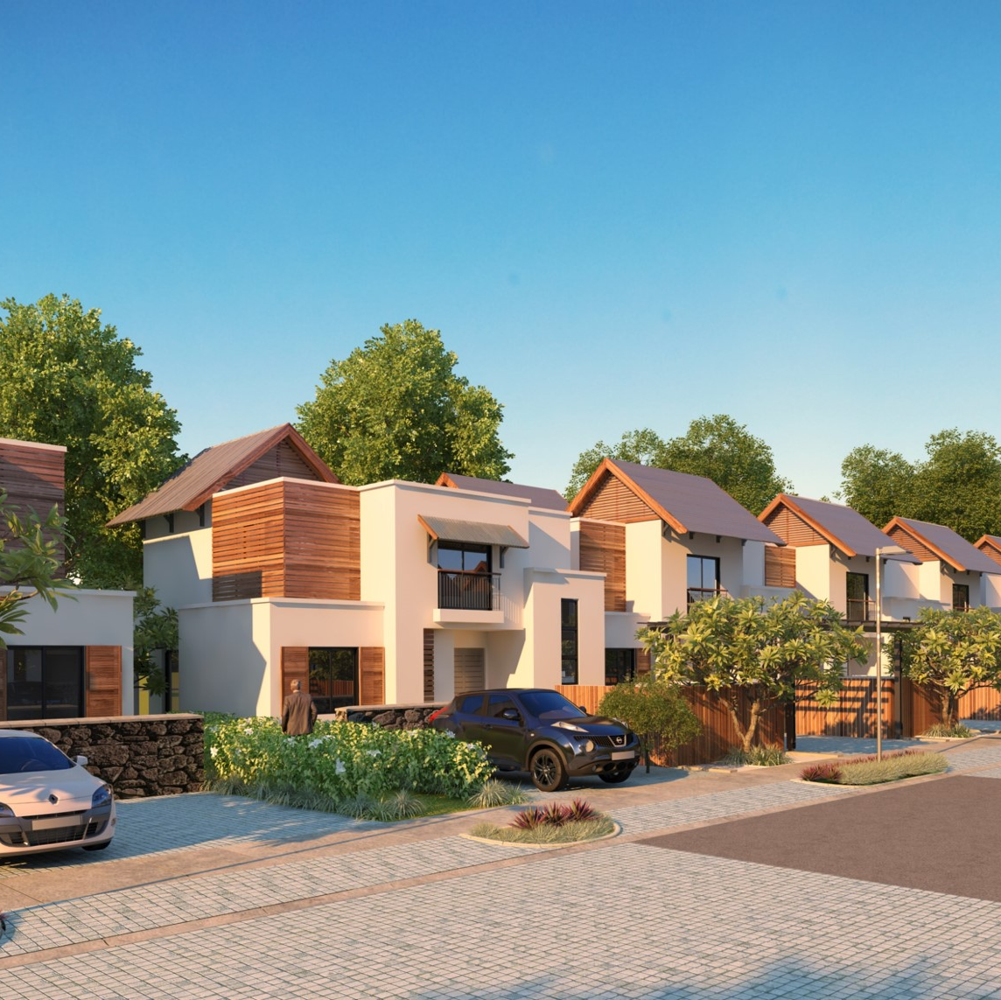
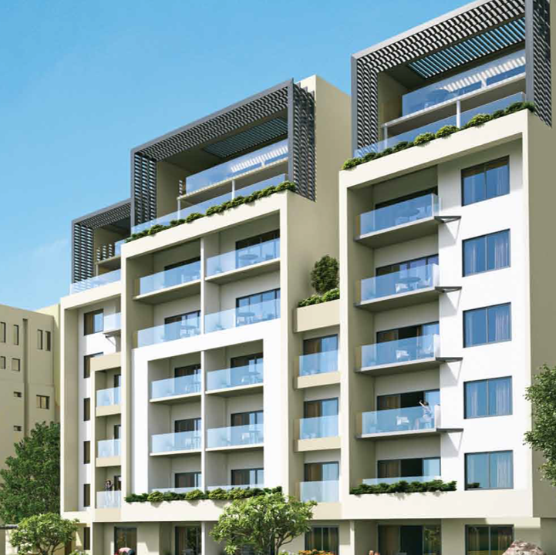
Acquiring a residential property in Mauritius
Where to Buy?
Residential property can be acquired by Non-Citizens in the following schemes:
IRS
(Integrated Resort Scheme)
RES
(Real Estate Scheme)
PDS
(Property Development Scheme)
SCS
(Smart City Scheme)
G+2
(apartments in Ground plus two buildings)

Slide 7
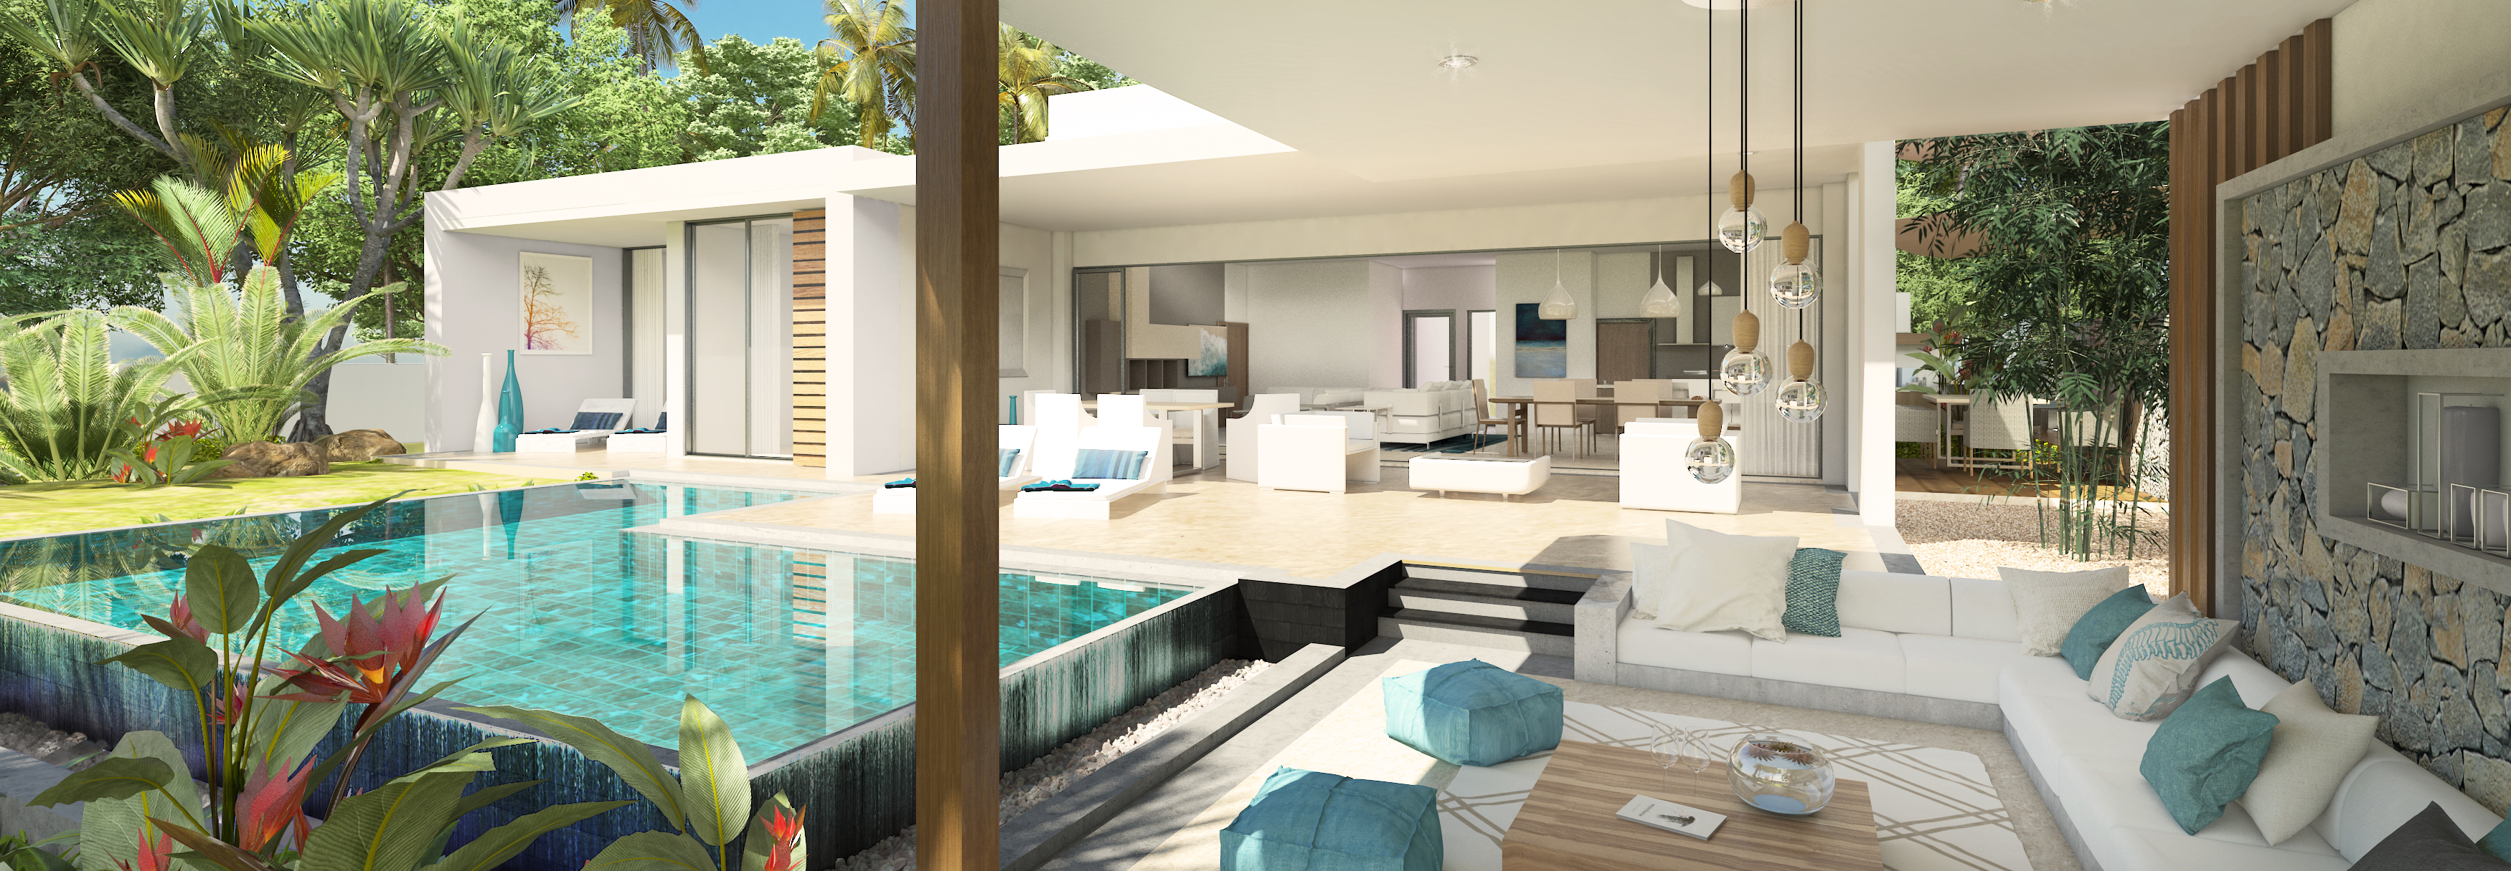
Acquiring a residential property in Mauritius
Residence Permit on investment of USD 375,000 in a residence
RP valid for as long as ownership of property is maintained
RP can be extended to dependents, including children
RP holders can invest or work in Mauritius without other permits
Eligibility for tax residency with a stay duration exceeding 183 days

Slide 8
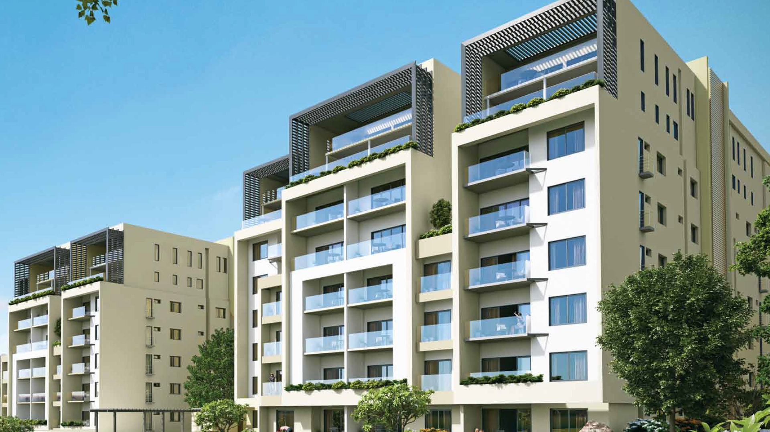
Acquiring Apartments in Ground plus Two buildings
Any non-Citizen can acquire an apartment
Complex should be in a building of at least Ground +Two floors
Minimum acquisition price of MUR 6 million (≈USD 150,000)
Registration Duty of 5%
Apartment can be placed in a rental pool

Slide 9
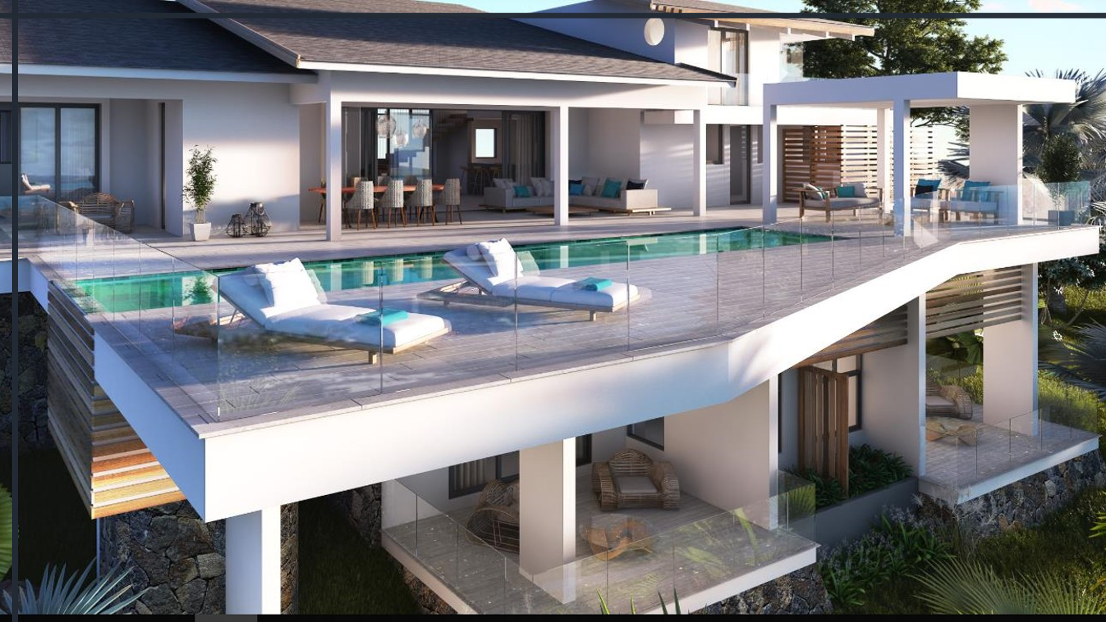
Property Development Scheme (PDS)
Residential Scheme regulated by EDB and which allows non-citizens to acquire a residence in Mauritius
High-end luxury residential development, with a minimum of (6) six residences (villa, apartment, etc) and commercial facilities
Sale effected on basis of plan, during construction or after construction, via a Notary public
Financial Completion Guarantee, biennial guarantee, Decennial Liability (Ten year Guarantee), Quality insurance on defects

Slide 10
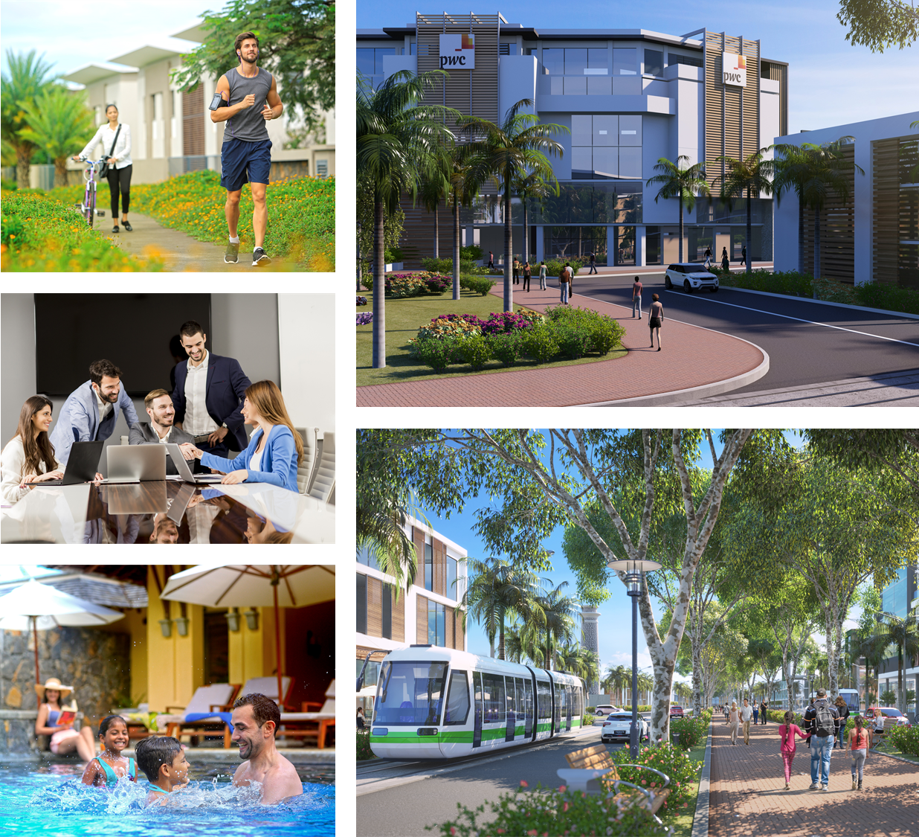
SMART CITY SCHEME (SCS)
WORK
LIVE
PLAY
Large Scale Mixed-Use Development
A balance of Work, Live and Play components and developments
Over land of a minimum extent of 50 Arpents (22 Ha)
Innovative and smart technologies, services and devices
Sustainable and Green urban living environment and infrastructure

Slide 11
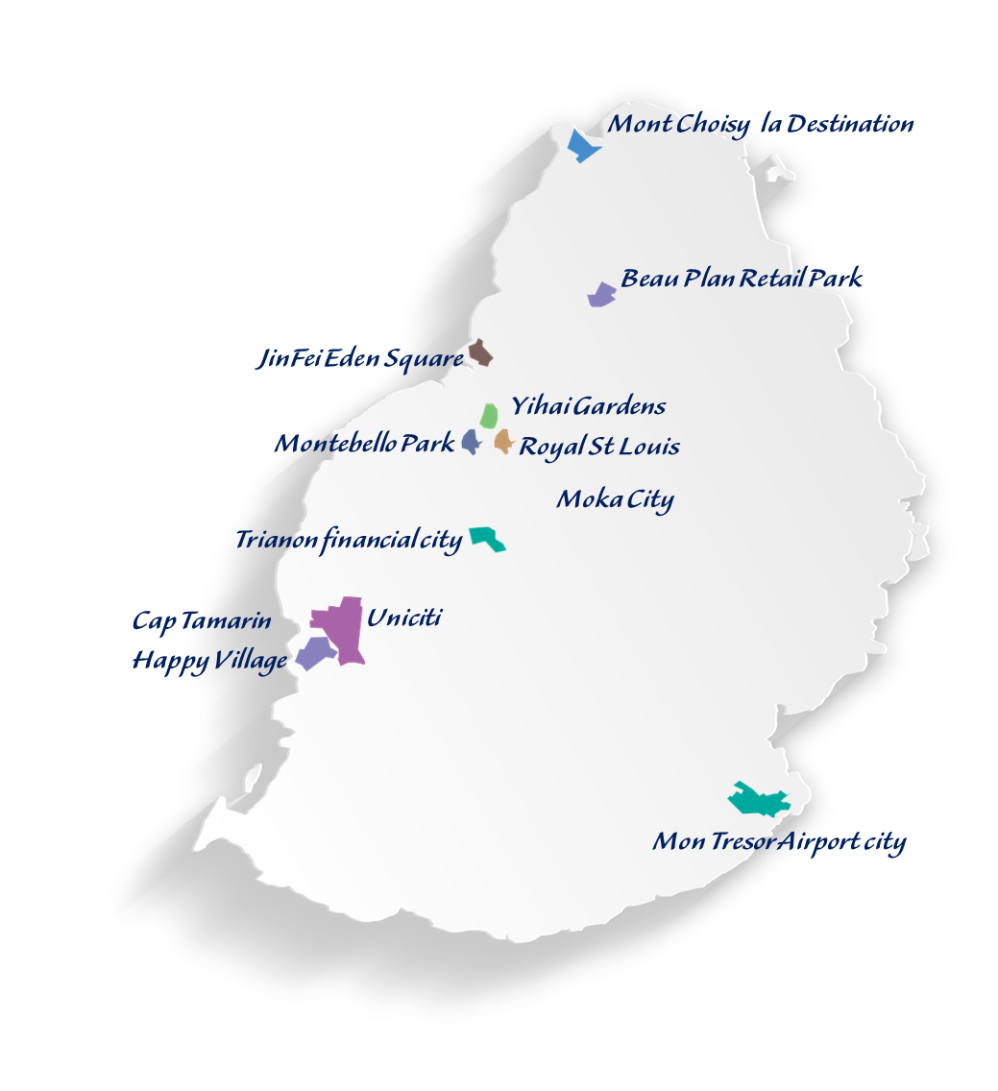
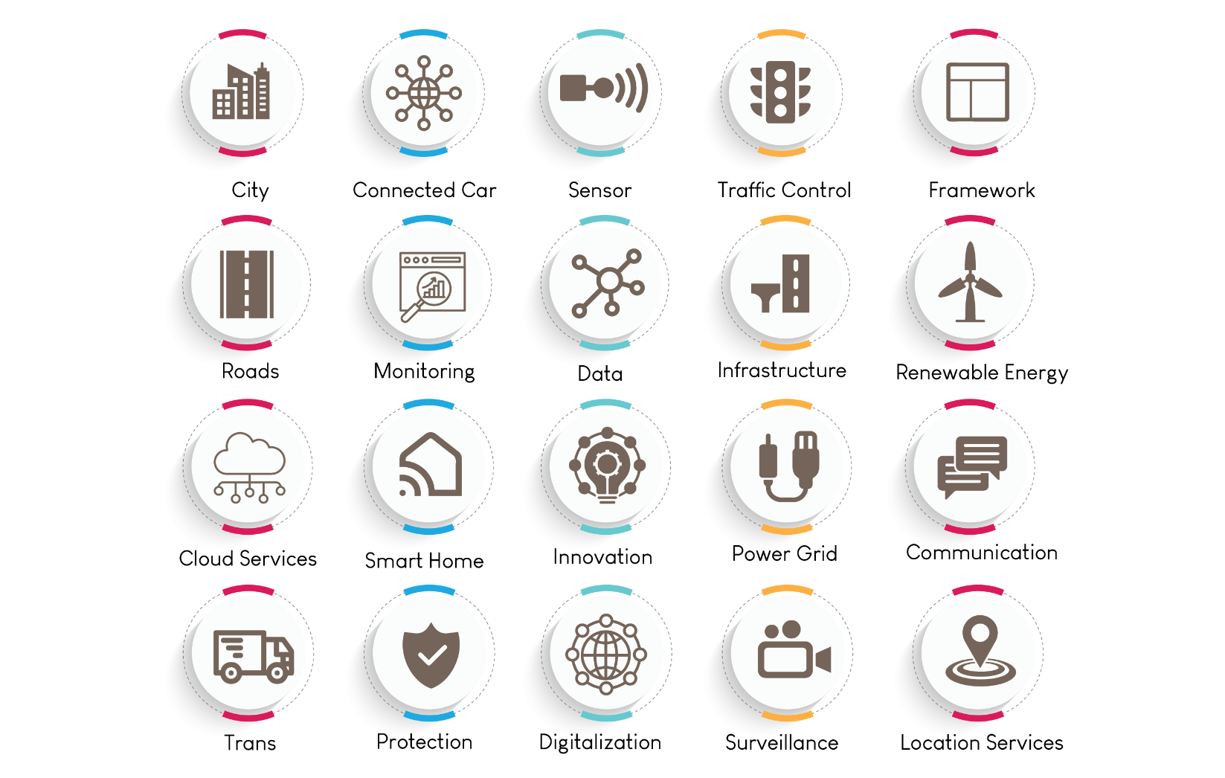
SMART CITY SCHEME (SCS)
11 Projects across the island
Investment Opportunities

Slide 12
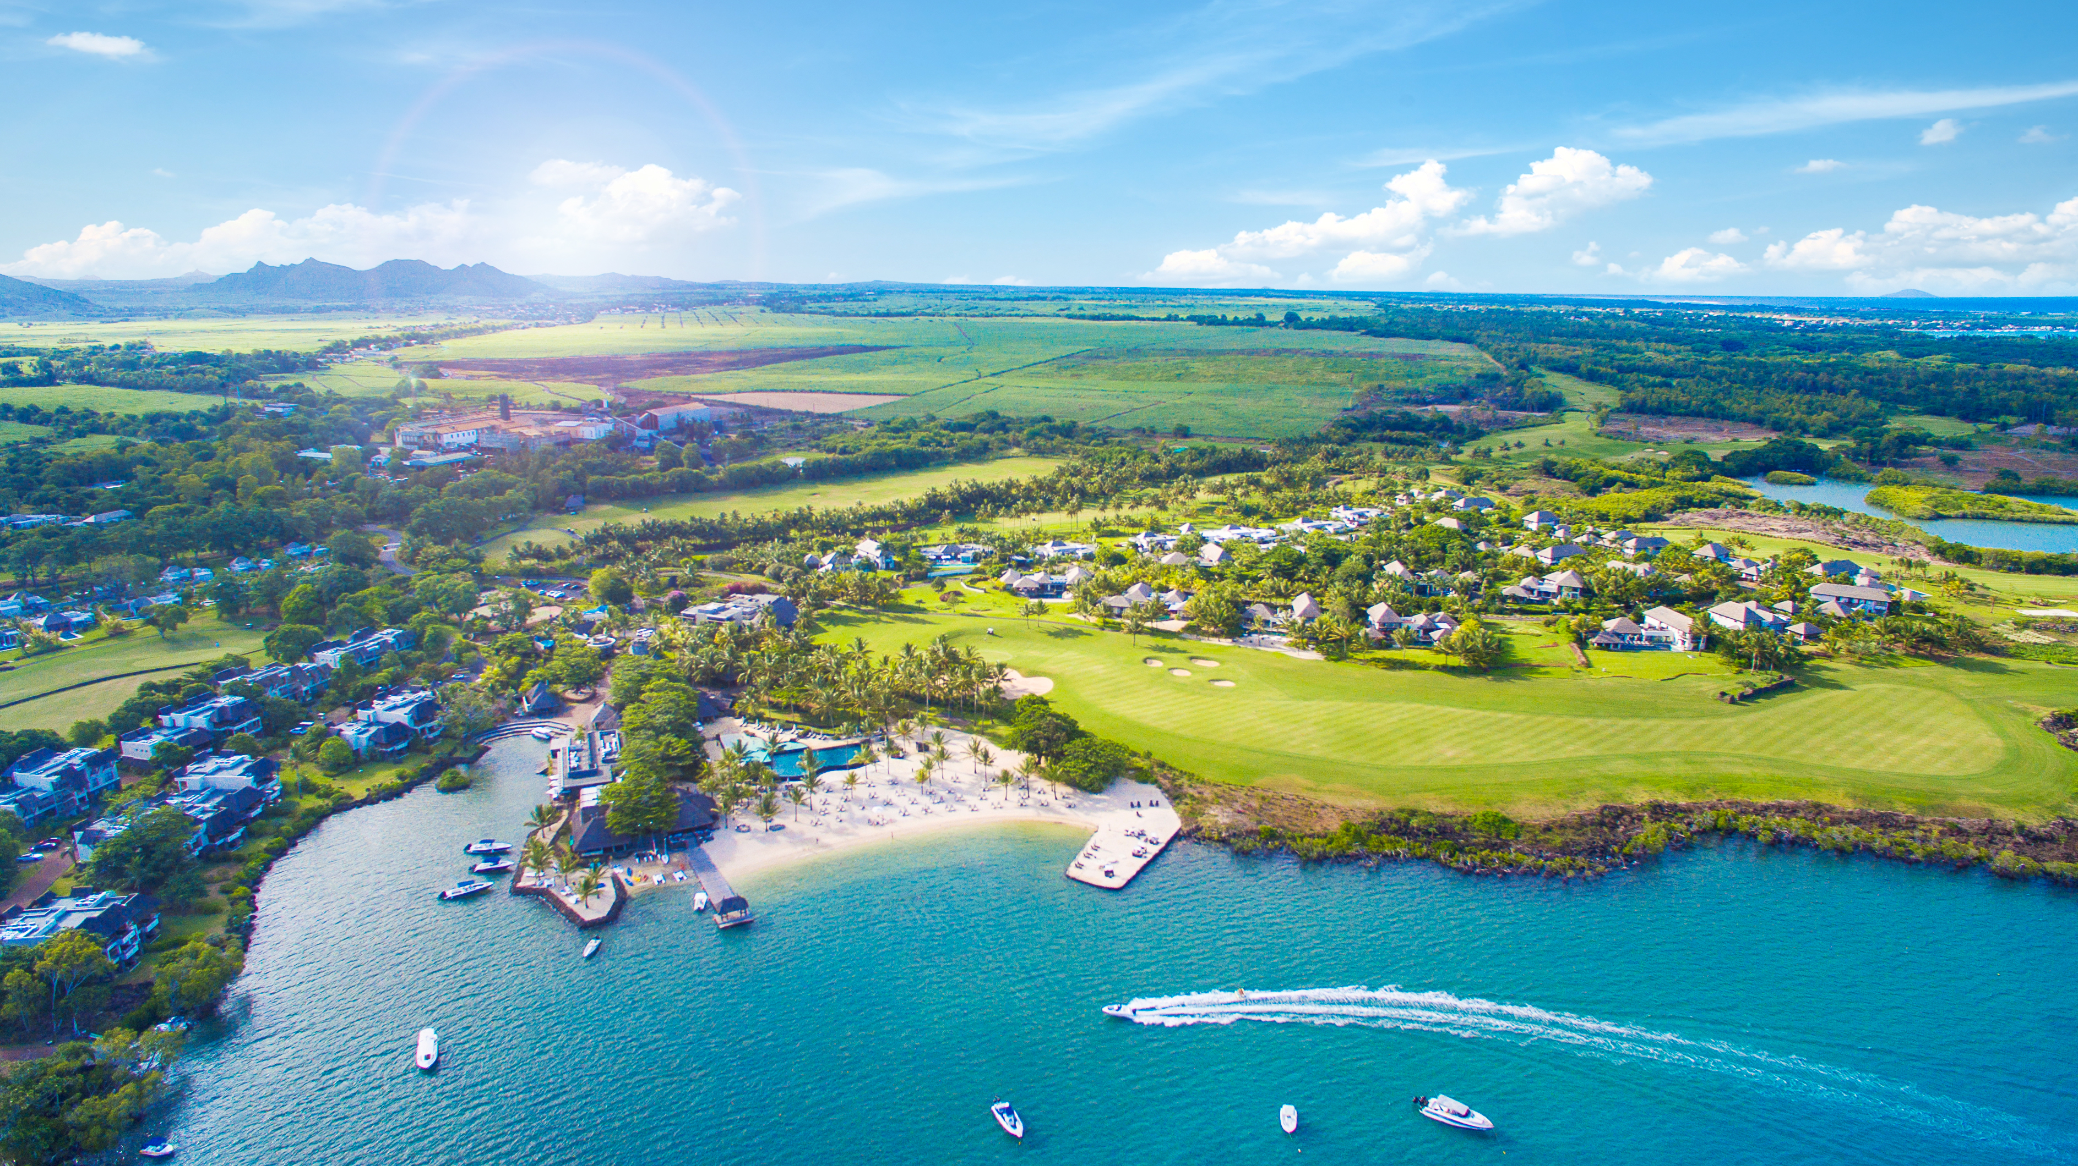
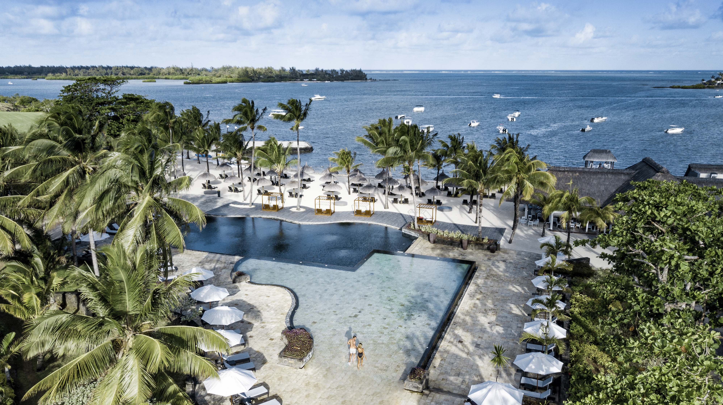
Hospitality

Slide 13
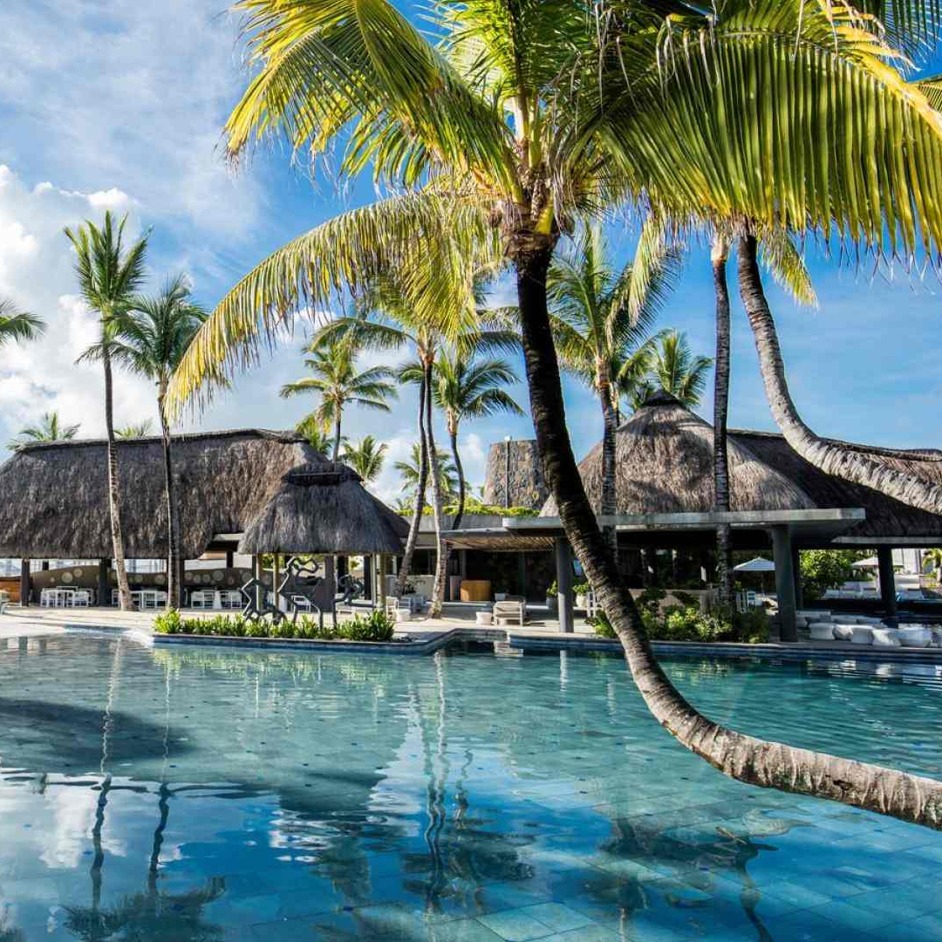






Hospitality
FIGURES
MAIN MARKETS
Tourists arrivals
French
1,38 million
TOURISM INDUSTRY
South
African
No. of Hotels
British
112
2019
Indian
Hotel occupancy
80.9%
German
Tourism earnings
USD 1.8 billion
Swiss

Slide 14
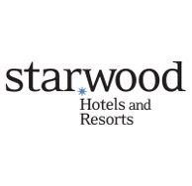







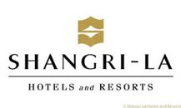



International Brands operating in Mauritius
MAIN MARKETS
French
South
African
British
Indian
German
Swiss

Slide 15




Investment Opportunities
Marina and related facilities
Gaming resorts & Leisure facilities
Wellness tourism
Hotel & resorts
Eco tourism
Yacht marina Catamaran Coastal ferry services
Golf Course
Theme parks
Dolphin watching Water Sports
Hot air balloon Bowling alleys
Medical facilities Religious and spiritual operators
Hotels, Resorts
High-end villas
Eco-Lodges
Adventure parks

